Slide 1
Classification & Logistic Reg. Basics Pavlos Protopapas

Slide 2
Outline
What is Classification?
Why not Linear Regression?
Estimating the Simple Logistic Model
Inference in Logistic Regression
Multiple Logistic Regression
Classification Decision Boundaries

Slide 3
What is Classification?
Advertising Data (from earlier lectures)
Y
continuous or quantitative
response variable
X
predictors
TV | Radio | Newspaper | Sales
230.1 | 37.8 | 69.2 | 22.1
44.5 | 39.3 | 45.1 | 10.4
17.2 | 45.9 | 69.3 | 9.3
151.5 | 41.3 | 58.5 | 18.5
180.8 | 10.8 | 58.4 | 12.9
n observations
p predictors

Slide 4
What is Classification?
Consider another dataset that contains a binary outcome AHD for 303 patients who presented with chest pain.
Y
Yes or No
response variable
X
predictors
Age | Sex | ChestPain | RestBP | Chol | MaxHR | ExAng | Thal | AHD
63 | 1 | typical | 145 | 233 | 150 | 0 | fixed | No
67 | 1 | asymptomatic | 160 | 286 | 108 | 1 | normal | Yes
67 | 1 | asymptomatic | 120 | 229 | 129 | 1 | reversable | Yes
37 | 1 | nonanginal | 130 | 250 | 187 | 0 | normal | No
Notes:
Yes indicates the presence of heart disease based on an angiographic test,
No means no heart disease.
Sex: 0 for women

Slide 5
What is Classification?
Consider another dataset that contains a binary outcome AHD for 303 patients who presented with chest pain.
X
predictors
‘Yes’ indicates presence of heart disease
Age | Sex | ChestPain | RestBP | Chol | MaxHR | ExAng | Thal | AHD
63 | 1 | typical | 145 | 233 | 150 | 0 | fixed | No
67 | 1 | asymptomatic | 160 | 286 | 108 | 1 | normal | Yes
67 | 1 | asymptomatic | 120 | 229 | 129 | 1 | reversable | Yes
37 | 1 | nonanginal | 130 | 250 | 187 | 0 | normal | No
Notes:
Yes indicates the presence of heart disease based on an angiographic test,
No means no heart disease.
Sex: 0 for women

Slide 6
What is Classification?
Consider another dataset that contains a binary outcome AHD for 303 patients who presented with chest pain.
X
predictors
‘No’ indicates absence of heart disease
Age | Sex | ChestPain | RestBP | Chol | MaxHR | ExAng | Thal | AHD
63 | 1 | typical | 145 | 233 | 150 | 0 | fixed | No
67 | 1 | asymptomatic | 160 | 286 | 108 | 1 | normal | Yes
67 | 1 | asymptomatic | 120 | 229 | 129 | 1 | reversable | Yes
37 | 1 | nonanginal | 130 | 250 | 187 | 0 | normal | No
Notes:
Sex: 0 for women, 1 for men

Slide 7



What is Classification?
In summary,
Regression
Classification
Performs well on tasks that require the prediction of a quantitative response variable.
Performs well on tasks that require the prediction of a categorical or qualitative response variable. It classifies an observation into a category or class labeled by Y.
What is the temperature going to be tomorrow?
Is it going to be hot or cold tomorrow?

Slide 8
Typical Classification Examples
Classification problems are ubiquitous in many domains, such as healthcare, finance, sports.
Some examples of classification problems are:
To determine whether a startup is worth investing in
To determine the disease type of patients based on various genomic markers
To determine if a user is more likely to click on an advertisement.
To determine if a given image is a real or a fake one

Slide 9

Typical Classification Examples
Classification problems are ubiquitous in many domains, such as healthcare, finance, sports.
Some examples of classification problems are:
To determine whether a startup is worth investing in.

Slide 10

Typical Classification Examples
Classification problems are ubiquitous in many domains, such as healthcare, finance, sports.
Some examples of classification problems are:
To determine whether a startup is worth investing in.
To determine if a user is more likely to click on an advertisement.

Slide 11

Typical Classification Examples
Classification problems are ubiquitous in many domains, such as healthcare, finance, sports.
Some examples of classification problems are:
To determine whether a startup is worth investing in.
To determine if a user is more likely to click on an advertisement.
To determine if a given image is a real or a fake one.
Classifier Model

Slide 12
Outline
What is Classification?
Why not Linear Regression?
Estimating the Simple Logistic Model
Inference in Logistic Regression
Multiple Logistic Regression
Classification Decision Boundaries

Slide 13
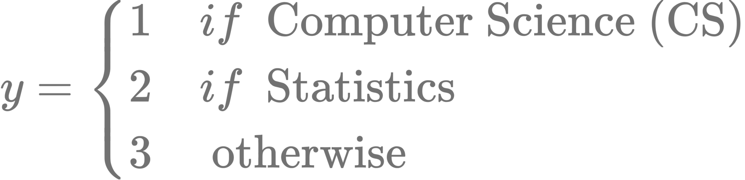
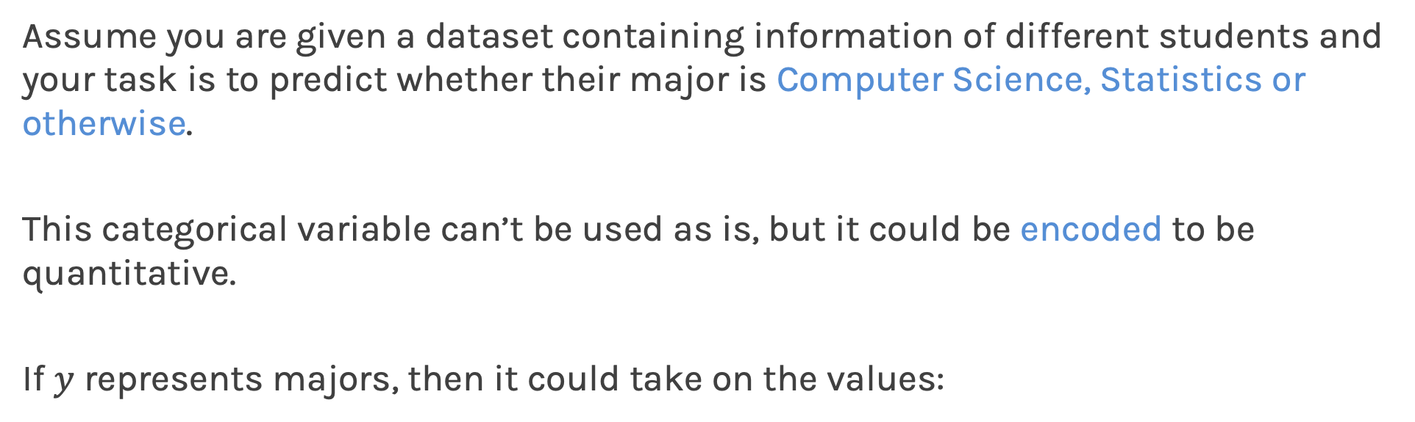
Why not Linear Regression?
Assume you are given a dataset containing information of different students and your task is to predict whether their major is Computer Science, Statistics or otherwise.
This categorical variable can’t be used as is, but it could be encoded to be quantitative.
If $y$ represents majors, then it could take on the values:

Slide 14

Why not Linear Regression?
Now that we have encoded the values, a linear regression could be used to predict $y$ from $x$.
Grades
Courses Taken
. . .
Linear Regression
But what is the problem here?

Slide 15

Why not Linear Regression?
This model would imply a specific ordering of the outcome.
For example, a change from y = 1 to y = 2 (Computer Science to Statistics) is considered the same as a change from y = 2 to y = 3 (Statistics to everyone else). However, this change should not be interpreted as the same.
Everyone else
Computer Science
Statistics

Slide 16
Why not Linear Regression?
If a categorical response variable is ordinal (has a natural ordering, like Freshman, Sophomore, etc.), then a linear regression model would make some sense but is still not ideal.
Additionally, if the ordering of the response variable is changed, the model estimates and predictions would be fundamentally different. For example, a model trained with y = 1 represents Statistics and y = 2 represents CS is different from a model trained with the original ordering.

Slide 17
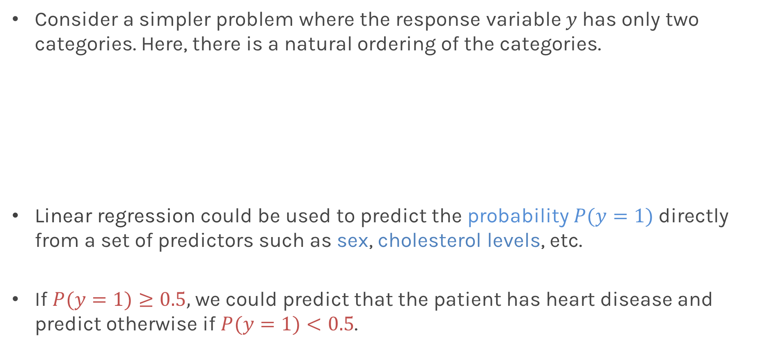
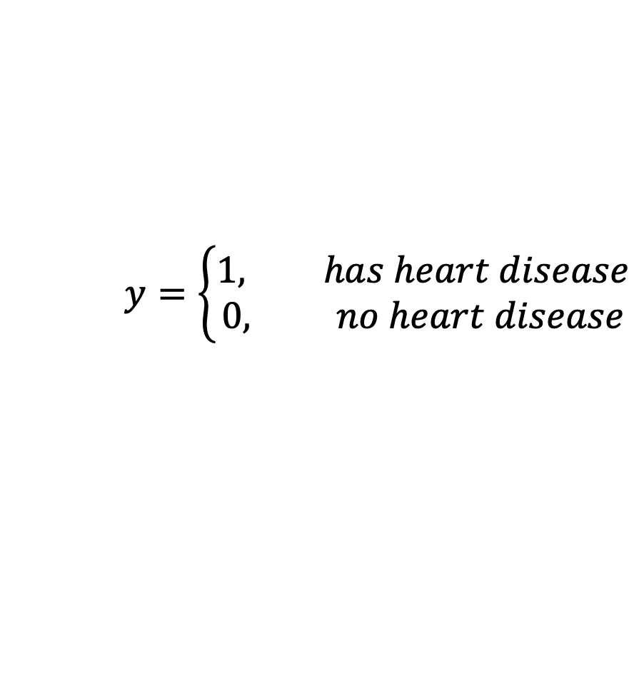
Why not Linear Regression?
Consider a simpler problem where the response variable $y$has only two categories. Here, there is a natural ordering of the categories.
Linear regression could be used to predict the probability $P(y=1)$ directly from a set of predictors such as sex, cholesterol levels, etc.
If $P(y=1)≥0.5,$ we could predict that the patient has heart disease and predict otherwise if $P(y=1)<0.5$.
$$y=\left\{\begin{aligned}1, has heart disease \\ 0, no heart disease\end{aligned}\right.$$

Slide 18
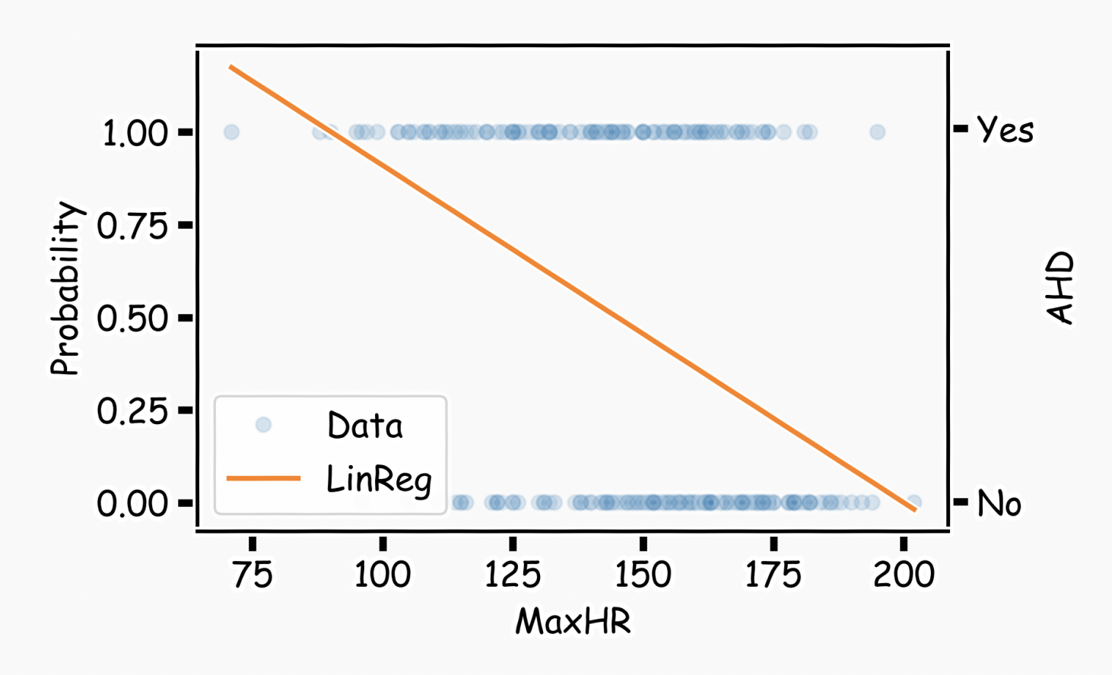
Why not Linear Regression?
What could go wrong with this linear regression model?
Notes:
CHANGE

Slide 19
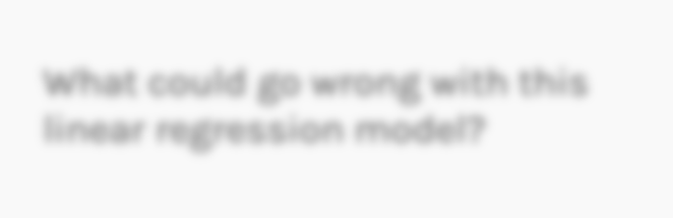

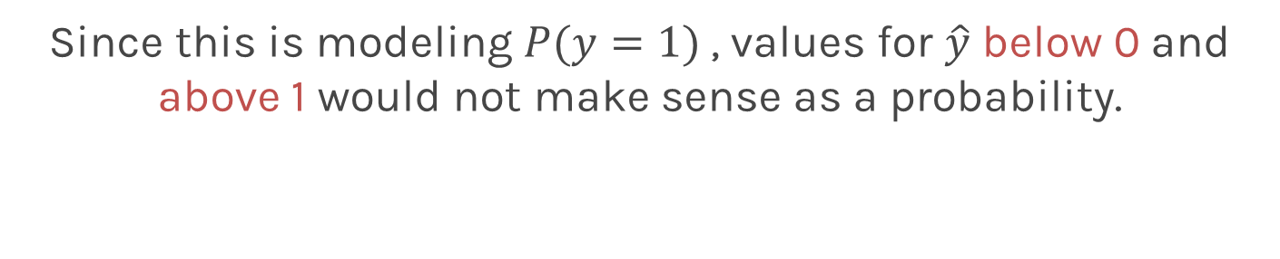
Why not Linear Regression?
What could go wrong with this linear regression model?
Since this is modeling $P(y=1)$, values for $\hat{y}$ below 0 and above 1 would not make sense as a probability.
Notes:
CHANGE

Slide 20
Outline
What is Classification?
Why not Linear Regression?
Estimating the Simple Logistic Model
Inference in Logistic Regression
Multiple Logistic Regression
Classification Decision Boundaries

Slide 21
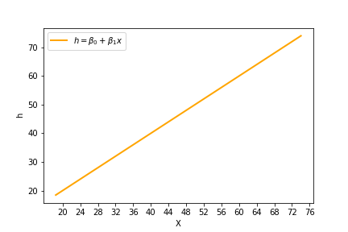
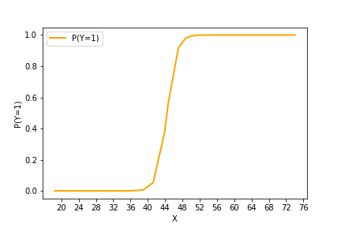
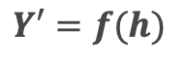
What function should we use?
Now we know that linear regression yields values for probability that are larger than 1 or smaller than 0. So, what can we do to fix this?
$$Y′=f(h)$$

Slide 22
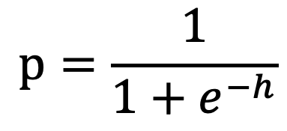
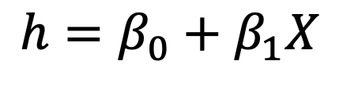
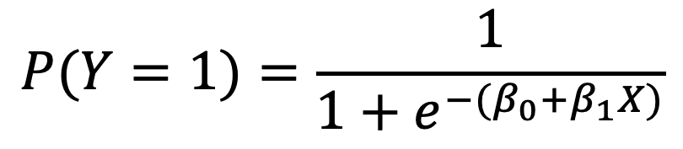
What function should we use?
We can use the sigmoid function:
$$p=\frac{1}{1+e^{−h}}$$
$$P(Y=1)=\frac{1}{1+e^{−(β_{0}+β_{1}X)}}$$
$$h=β_{0}+β_{1}X$$

Slide 23
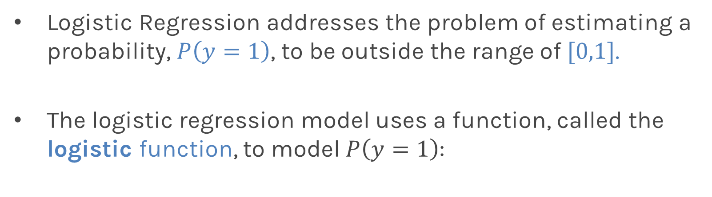
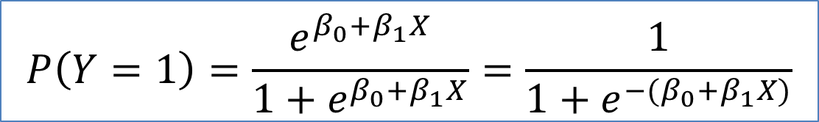
Logistic Regression
Logistic Regression addresses the problem of estimating a probability, $P\left(y=1\right)$, to be outside the range of $[0,1]$.
The logistic regression model uses a function, called the logistic function, to model $P\left(y=1\right)$:
$$P\left(Y=1\right)=\frac{e^{β_{0}+β_{1}X}}{1+e^{β_{0}+β_{1}X}}=\frac{1}{1+e^{−(β_{0}+β_{1}X)}}$$
What are the parameters of this model?

Slide 24
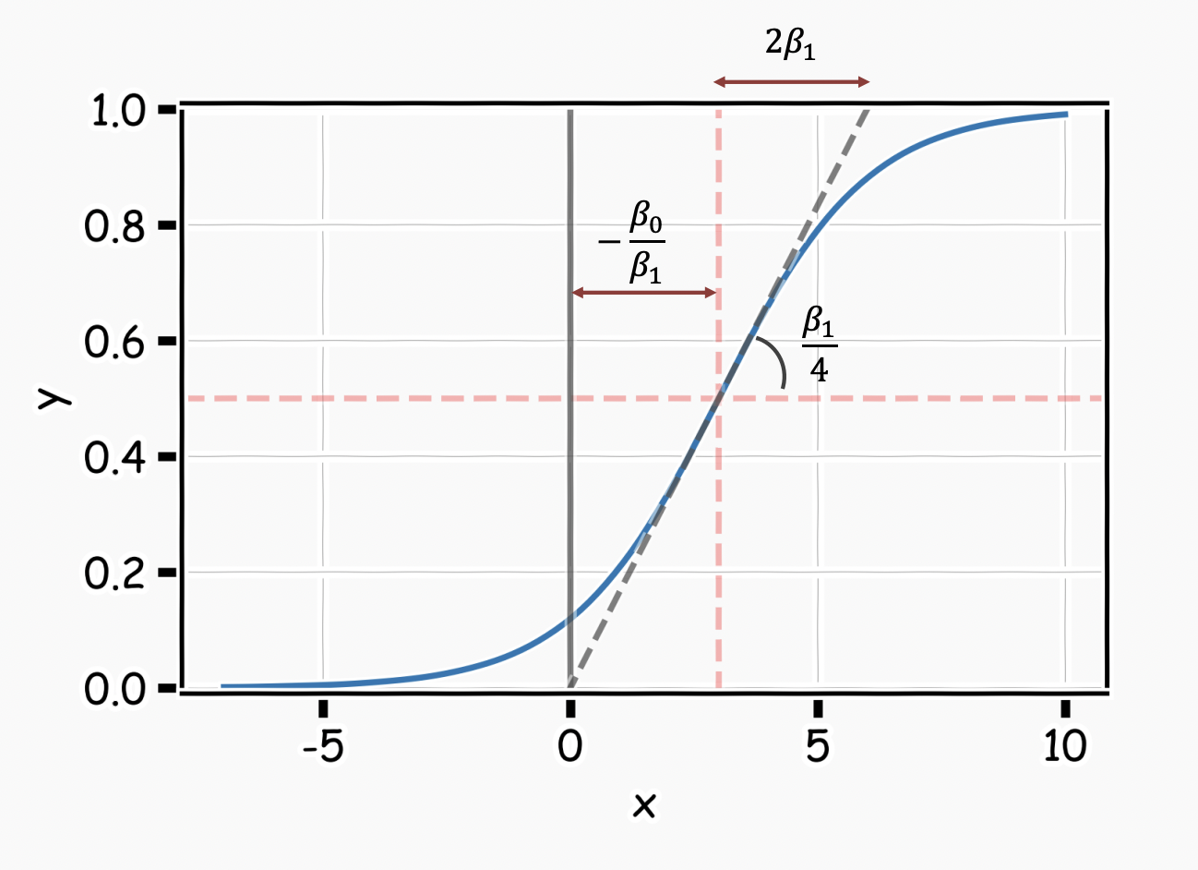
Logistic Regression
The coefficients $β_{0}$ and $β_{1}$ now control the shape of this S-shaped curve.

Slide 25
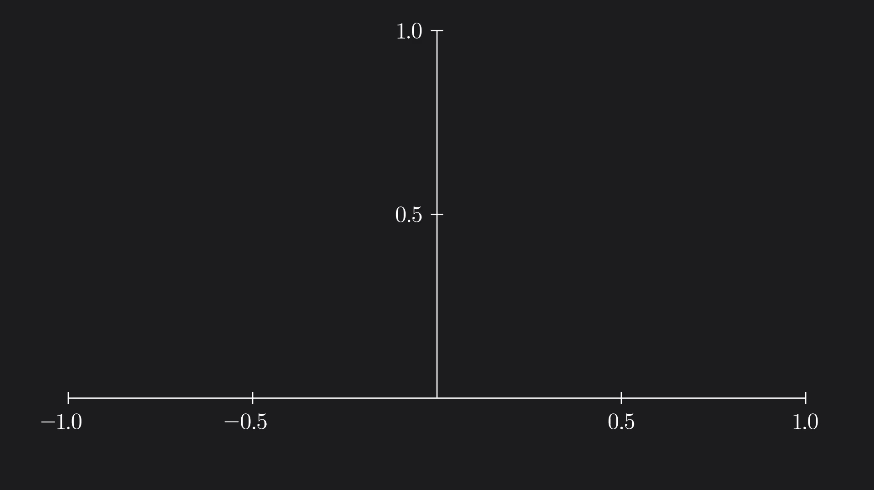
Sigmoid Animation

Slide 26
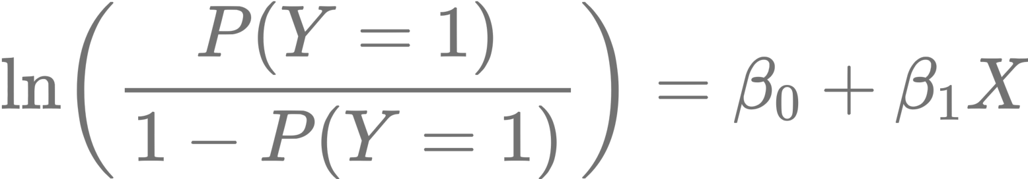
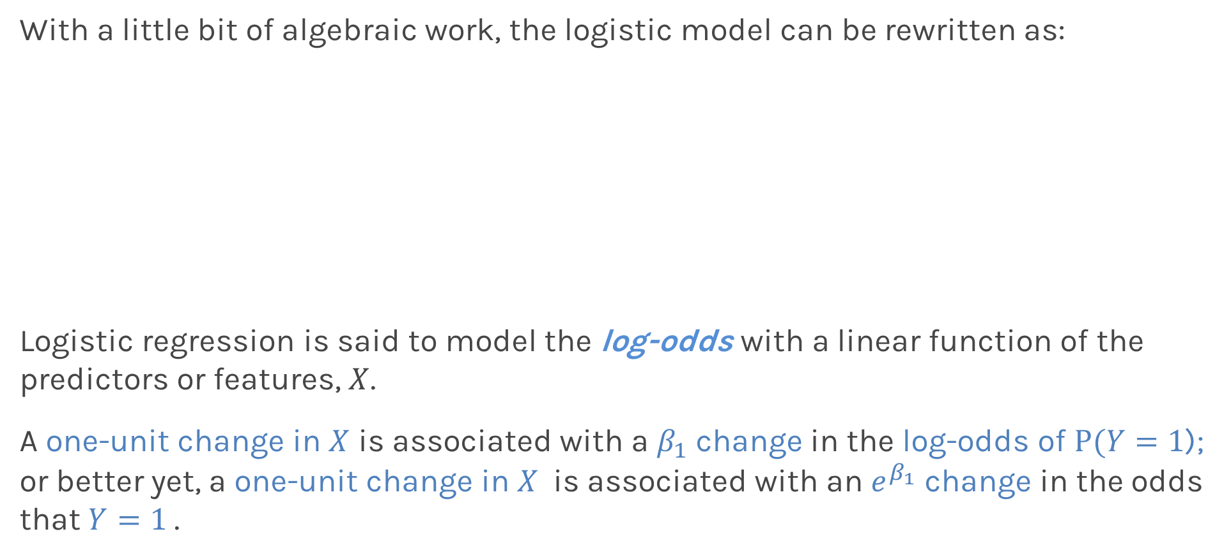
Interpretation of $β$’s
With a little bit of algebraic work, the logistic model can be rewritten as:
Logistic regression is said to model the log-odds with a linear function of the predictors or features, $X$.
A one-unit change in $X$ is associated with a $β_{1}$ change in the log-odds of $P(Y=1$); or better yet, a one-unit change in $X$ is associated with an $e^{β_{1}}$ change in the odds that $Y=1$.
odds

Slide 27
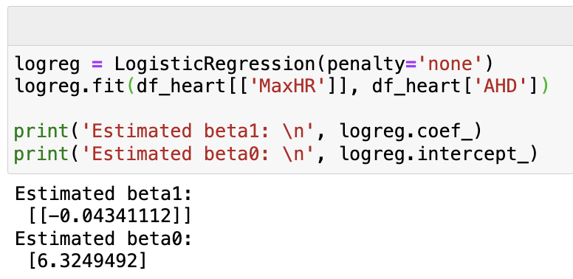
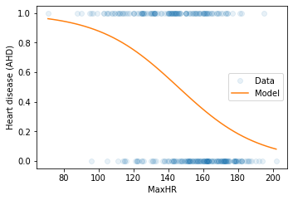
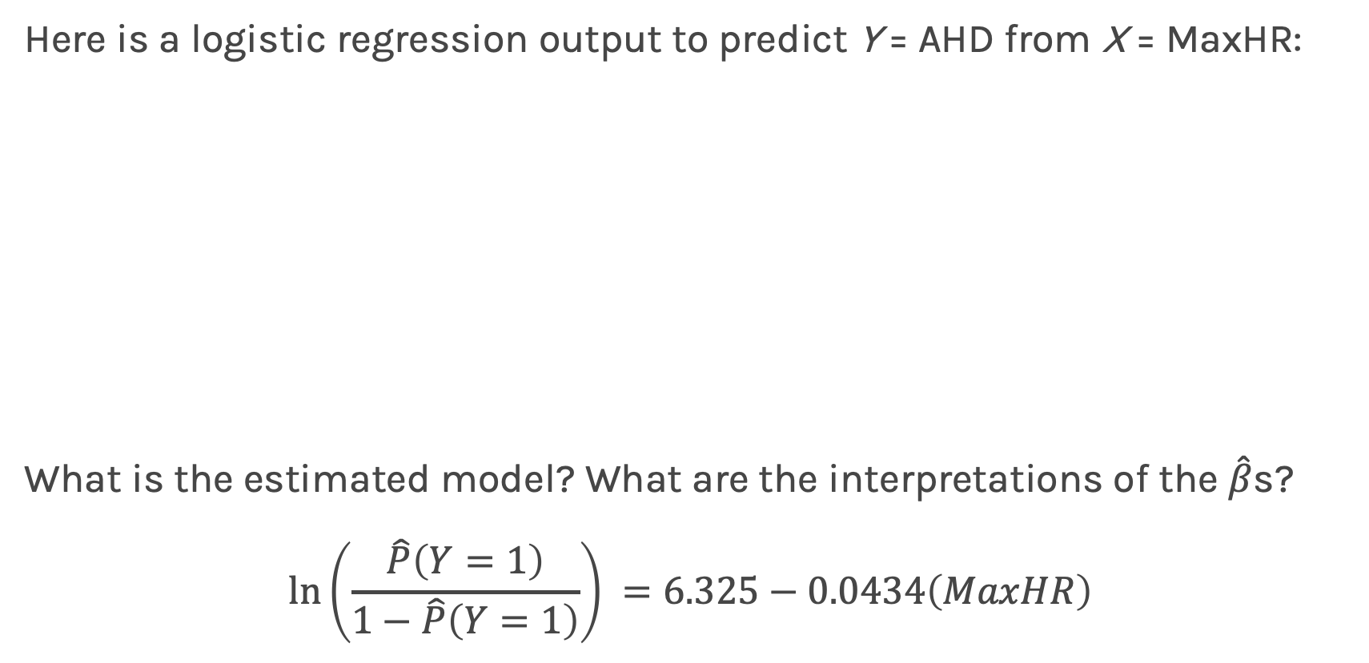
A First Logistic Regression Model in sklearn
Here is a logistic regression output to predict Y = AHD from X = MaxHR:
What is the estimated model? What are the interpretations of the $\hat{β}$s?
$$ln\left(\frac{\hat{P}\left(Y=1\right)}{1−\hat{P}\left(Y=1\right)}\right) =6.325−0.0434\left(MaxHR\right)$$

Slide 28
Estimating the Simple Logistic Model

Slide 29
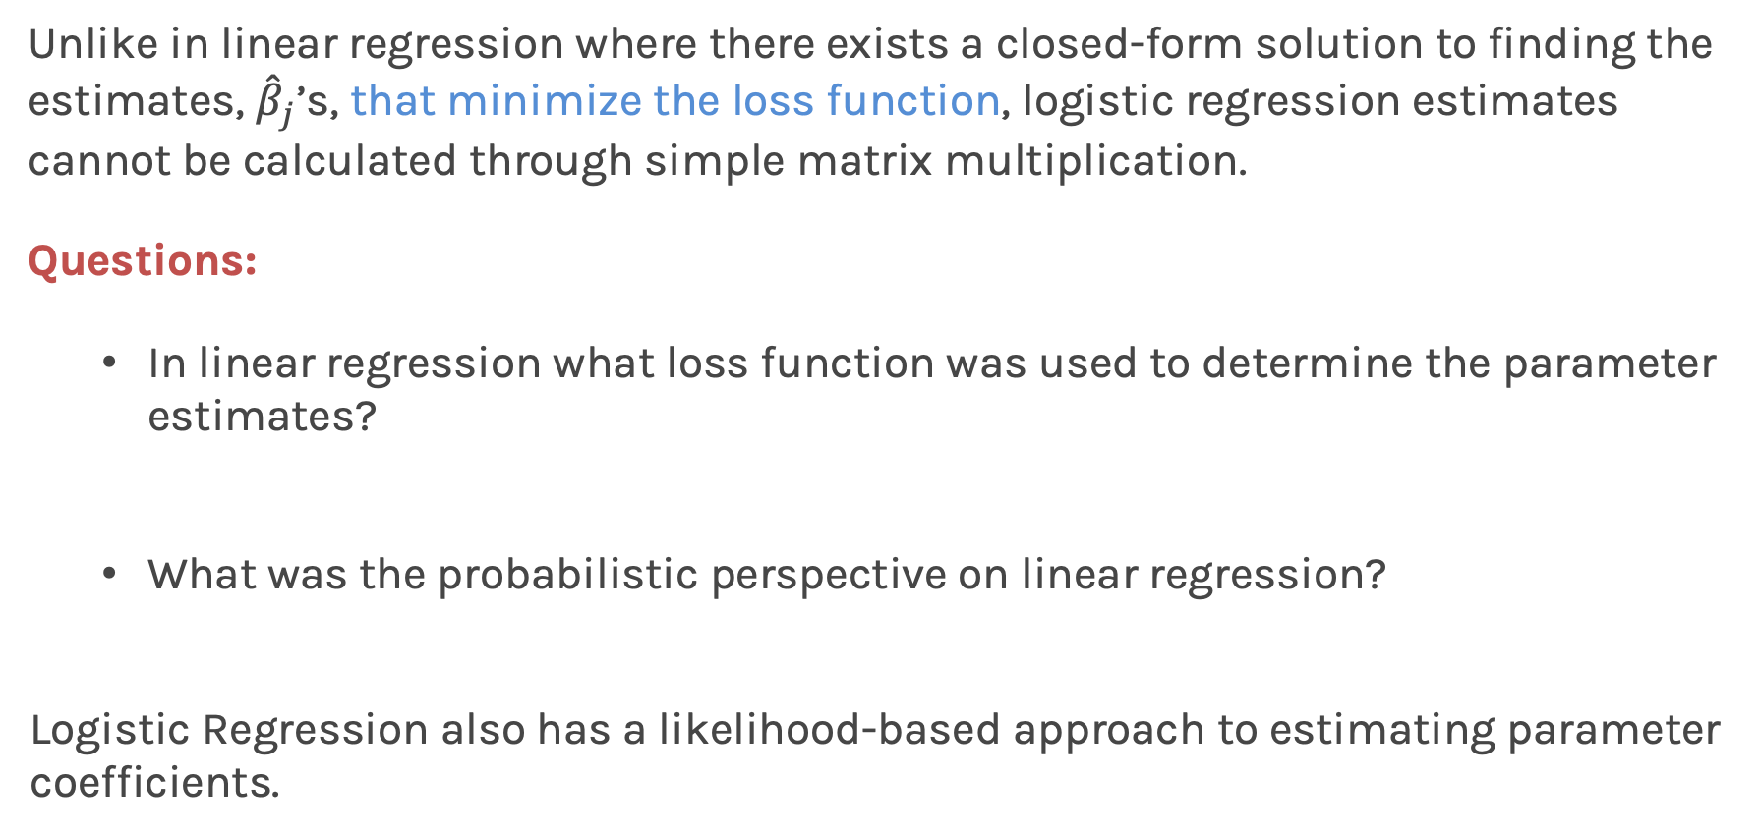
Estimating parameter coefficients
Unlike in linear regression where there exists a closed-form solution to finding the estimates, ${\hat{β}}_{j}$’s, that minimize the loss function, logistic regression estimates cannot be calculated through simple matrix multiplication.
Questions:
In linear regression what loss function was used to determine the parameter estimates?
What was the probabilistic perspective on linear regression?
Logistic Regression also has a likelihood-based approach to estimating parameter coefficients.
MSE
Normal Distribution

Slide 30
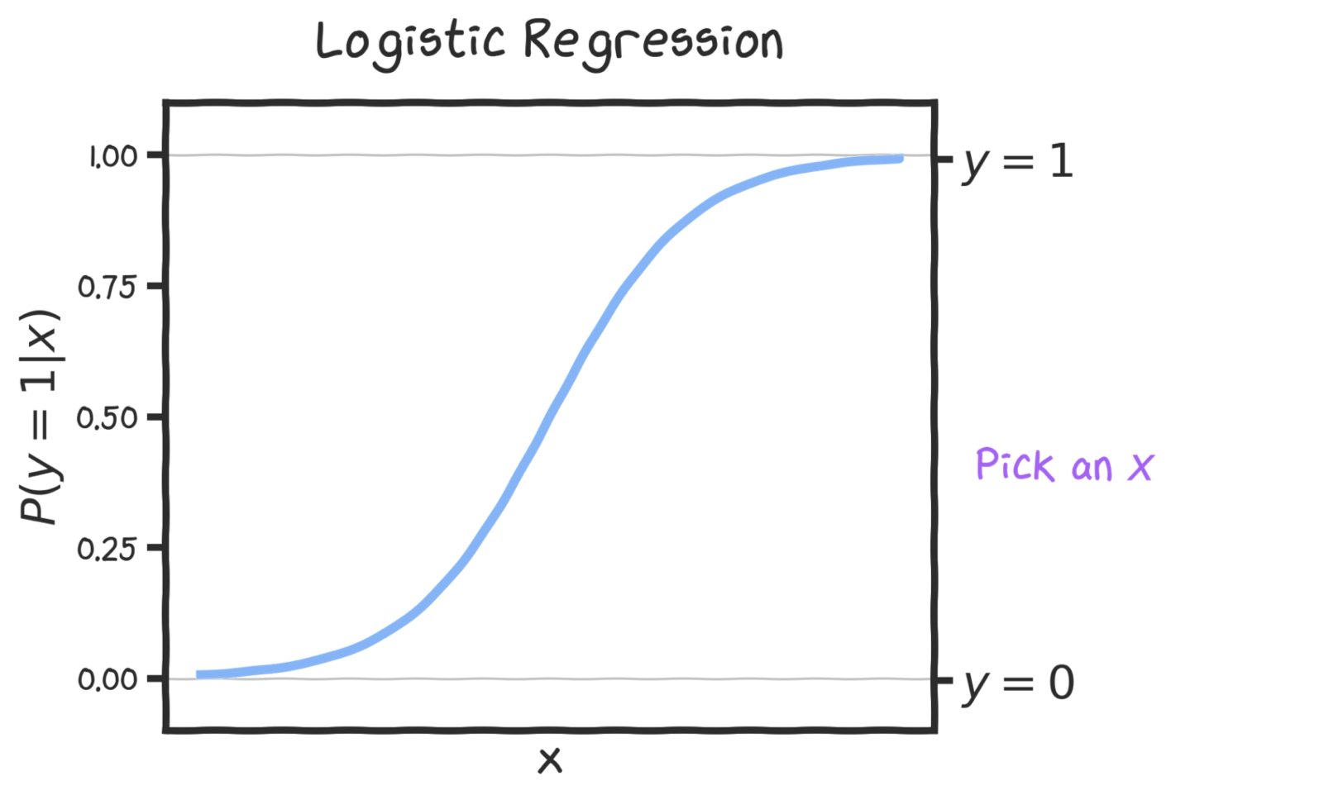

Slide 31
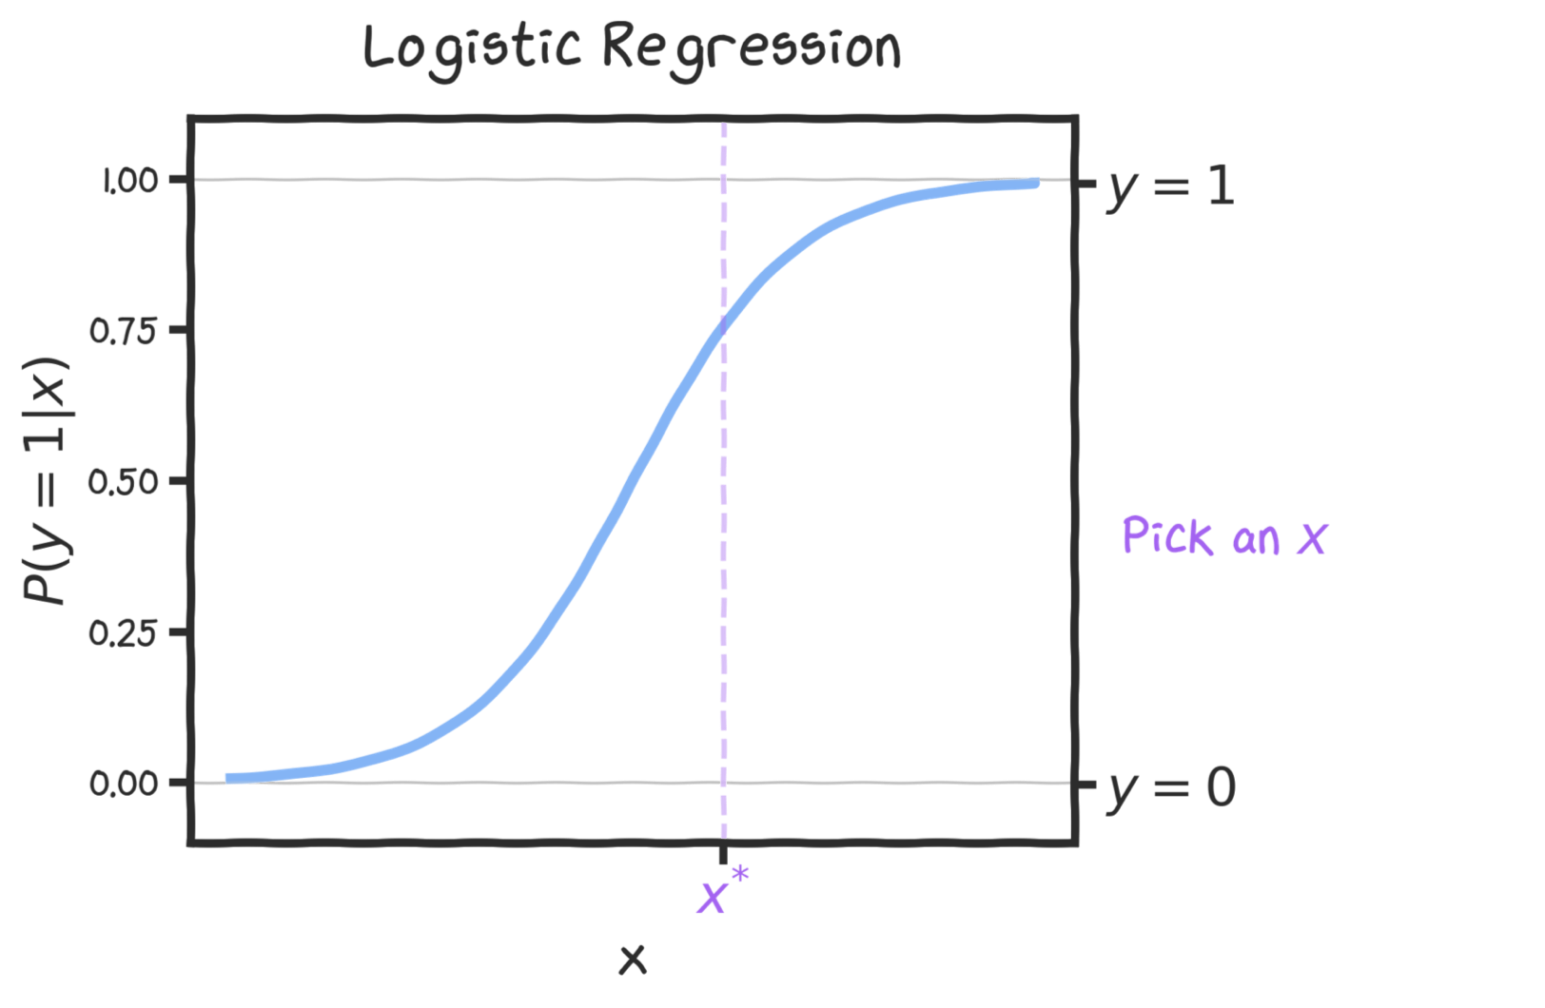

Slide 32
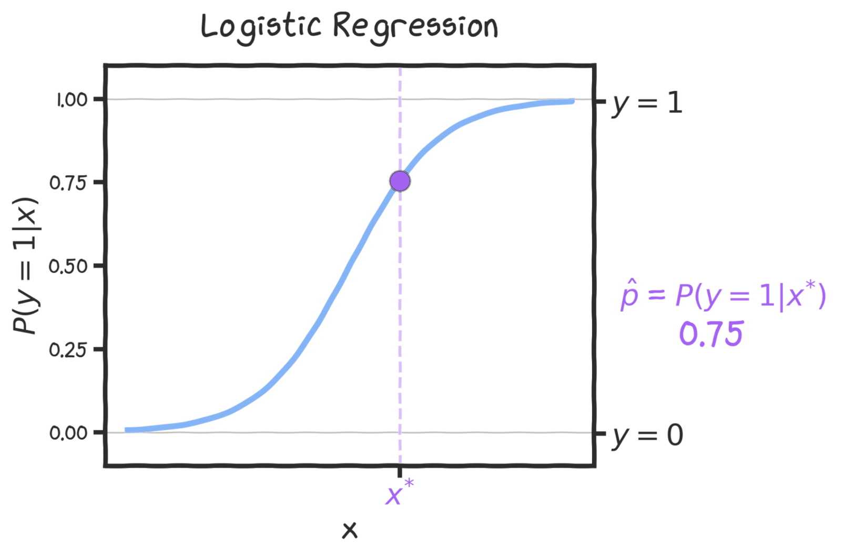

Slide 33
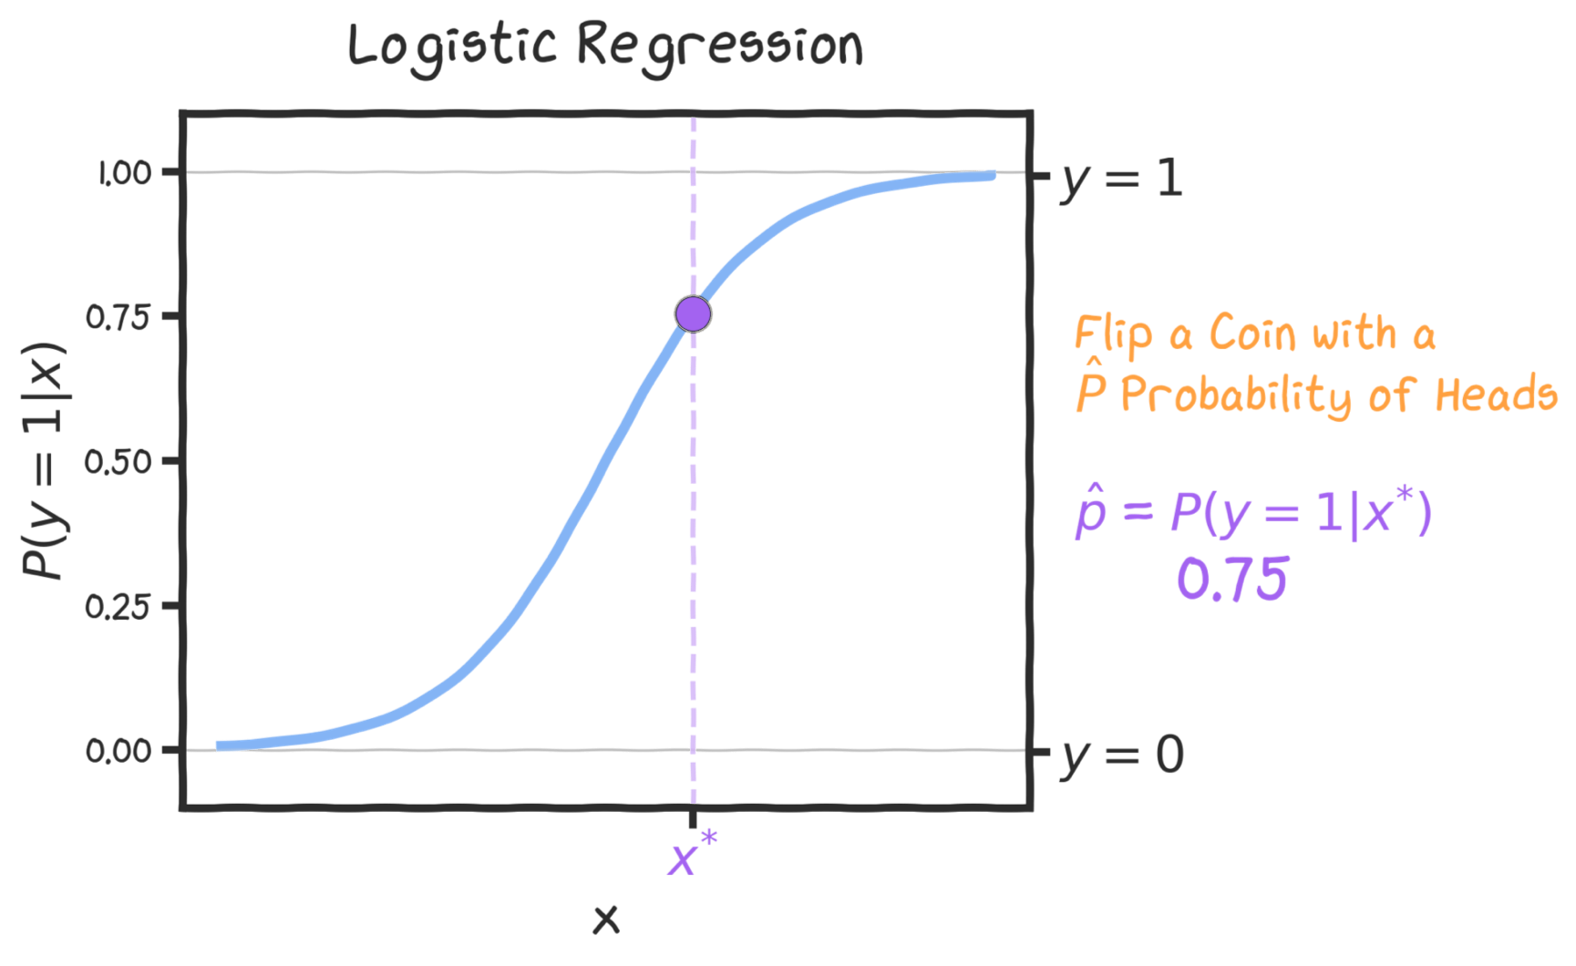

Slide 34
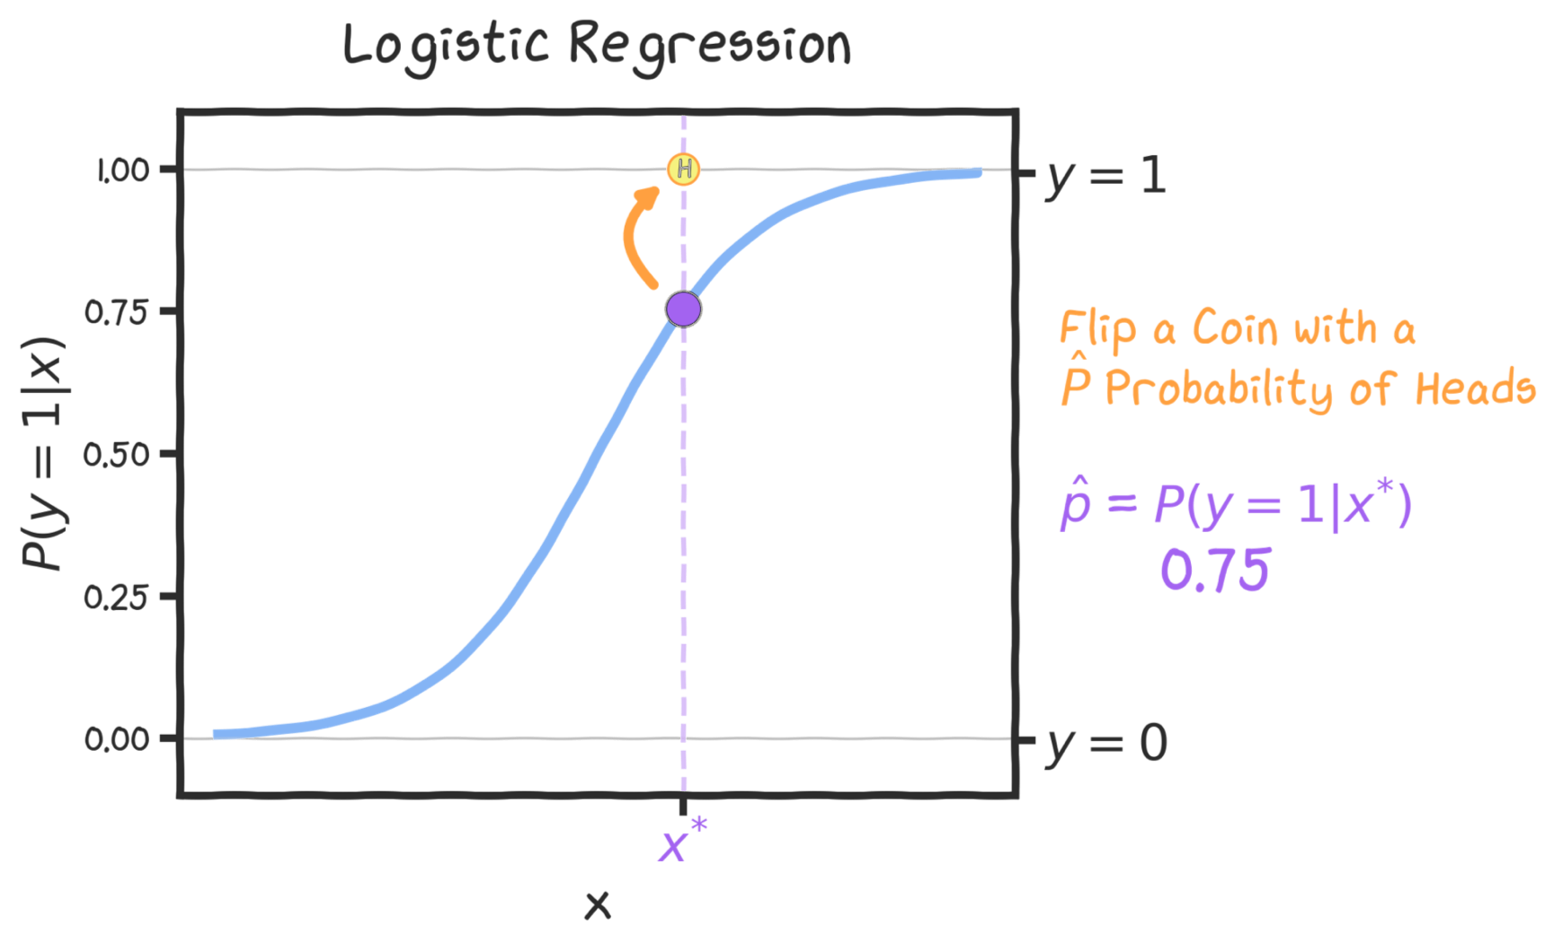

Slide 35
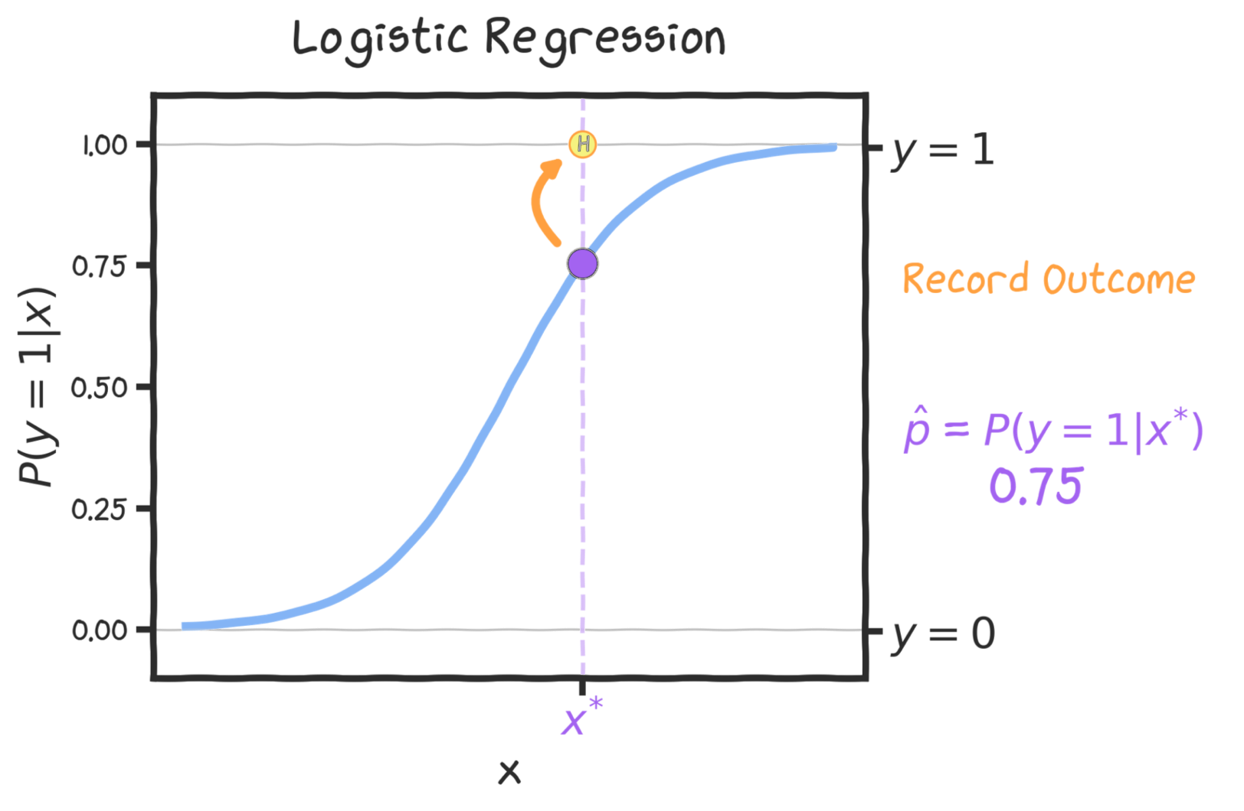

Slide 36
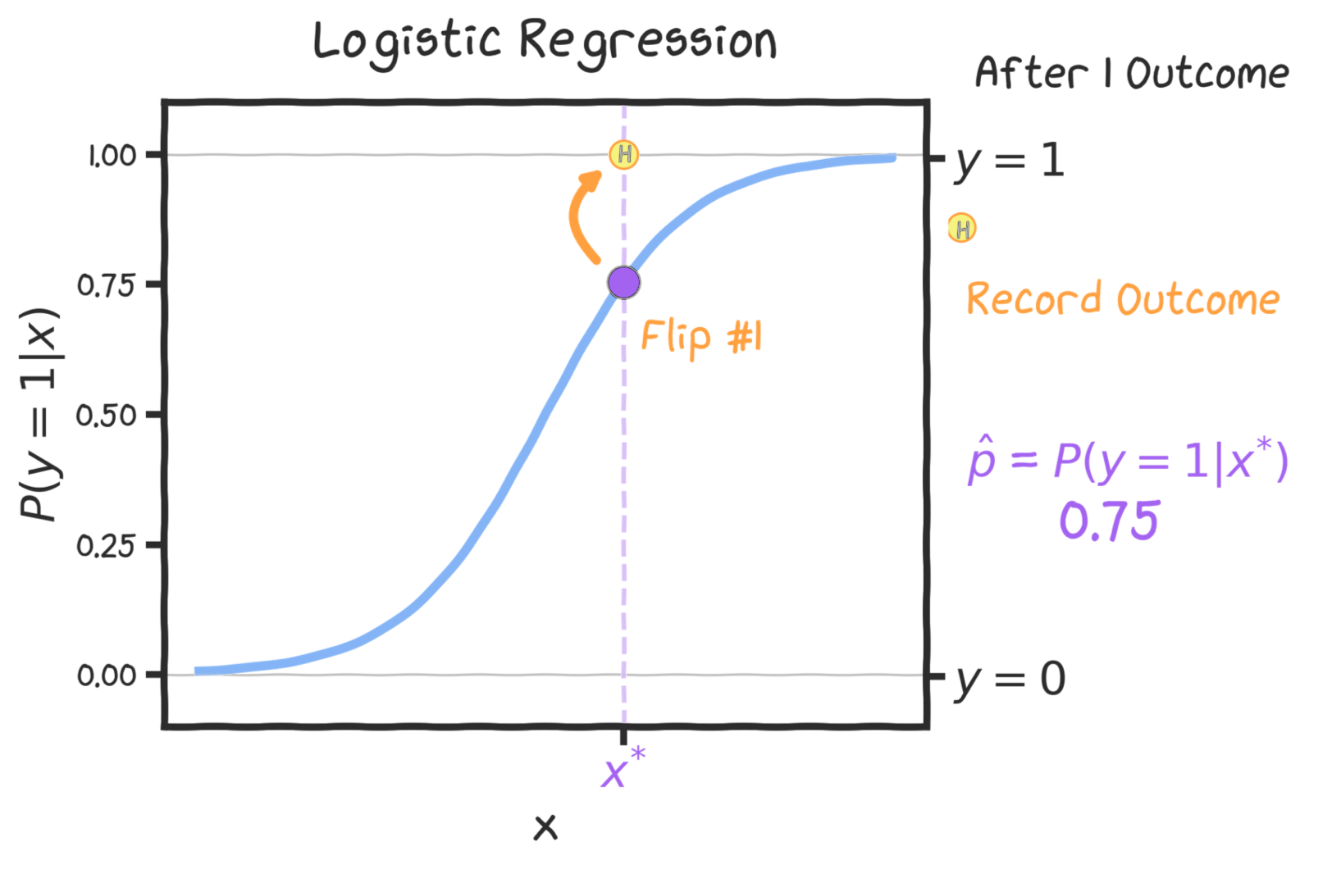

Slide 37
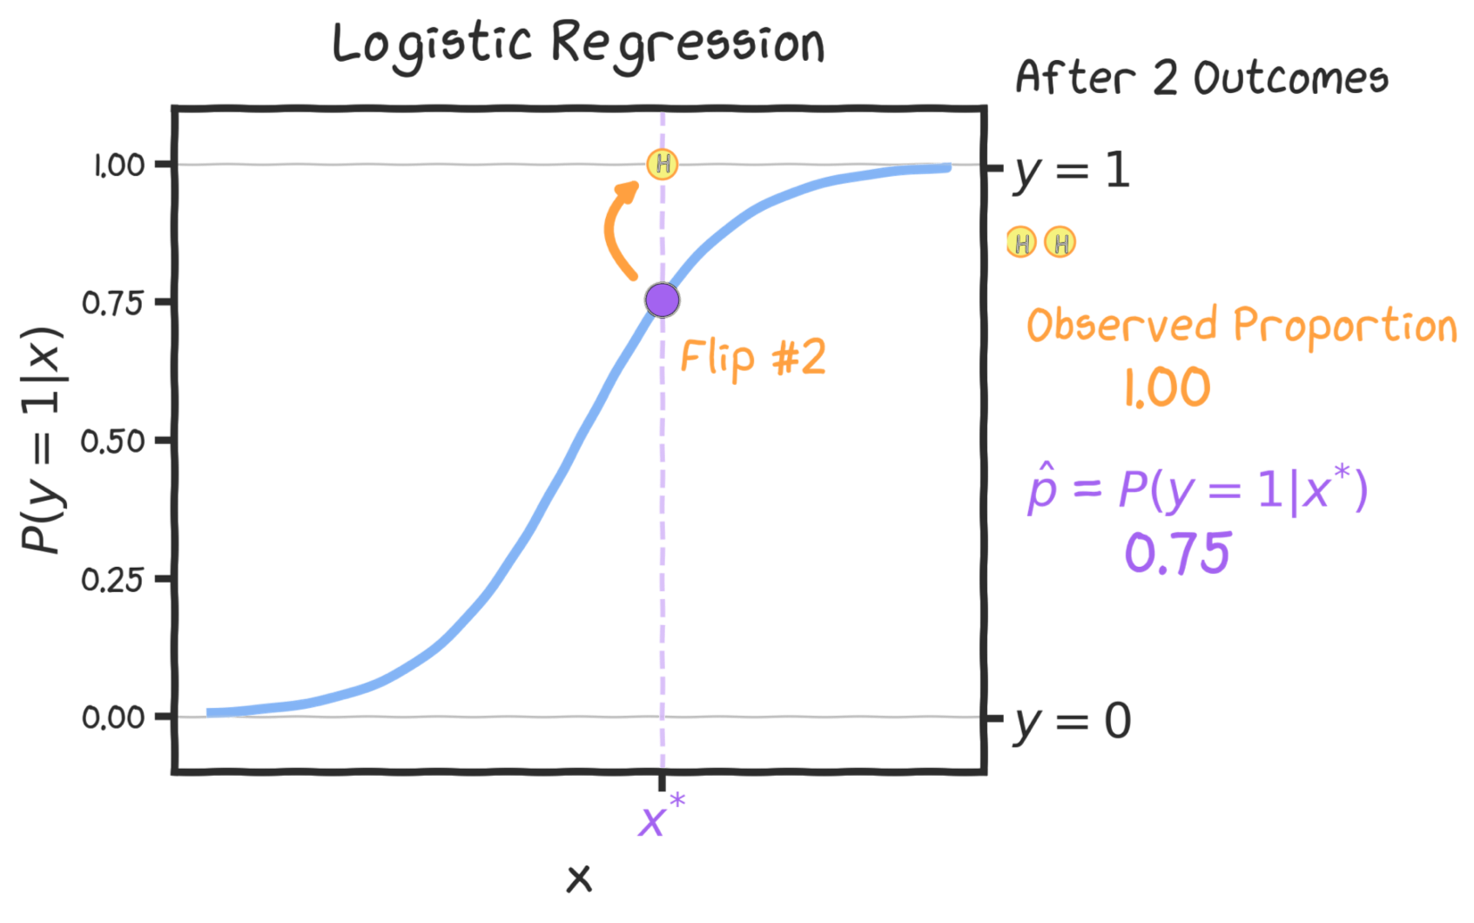

Slide 38
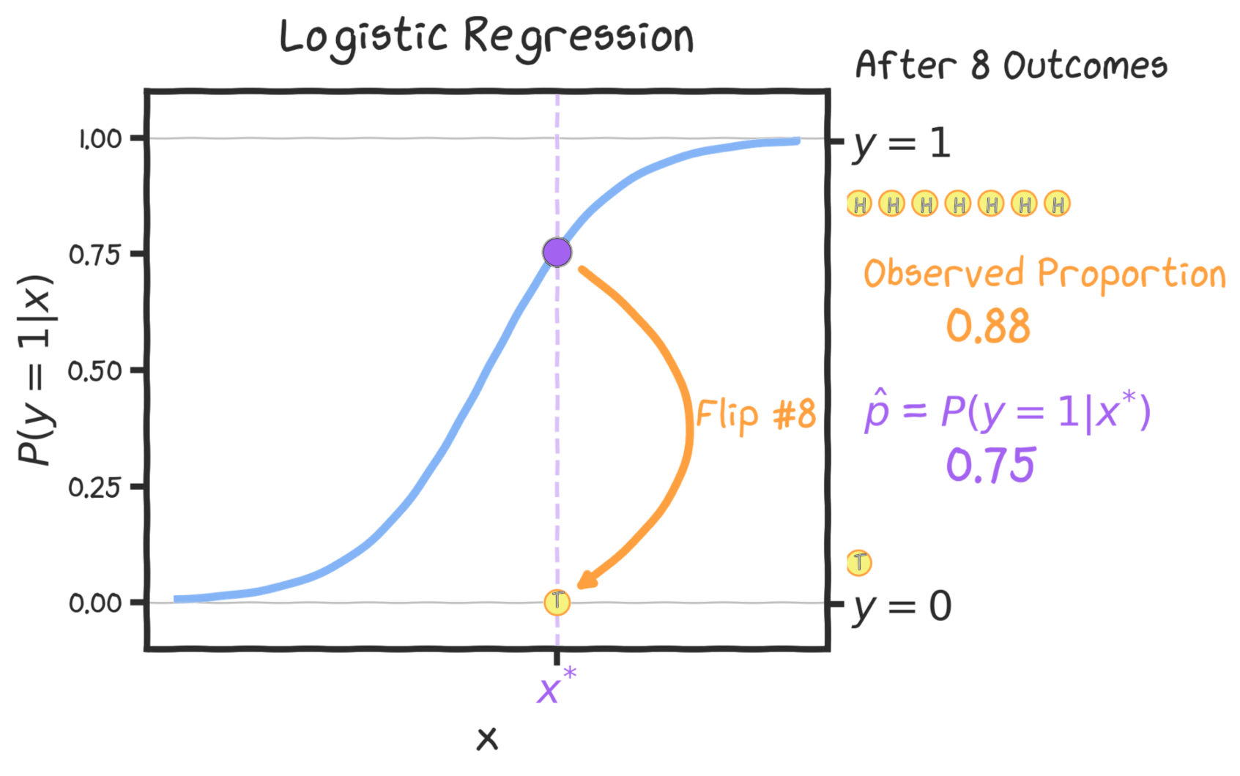

Slide 39
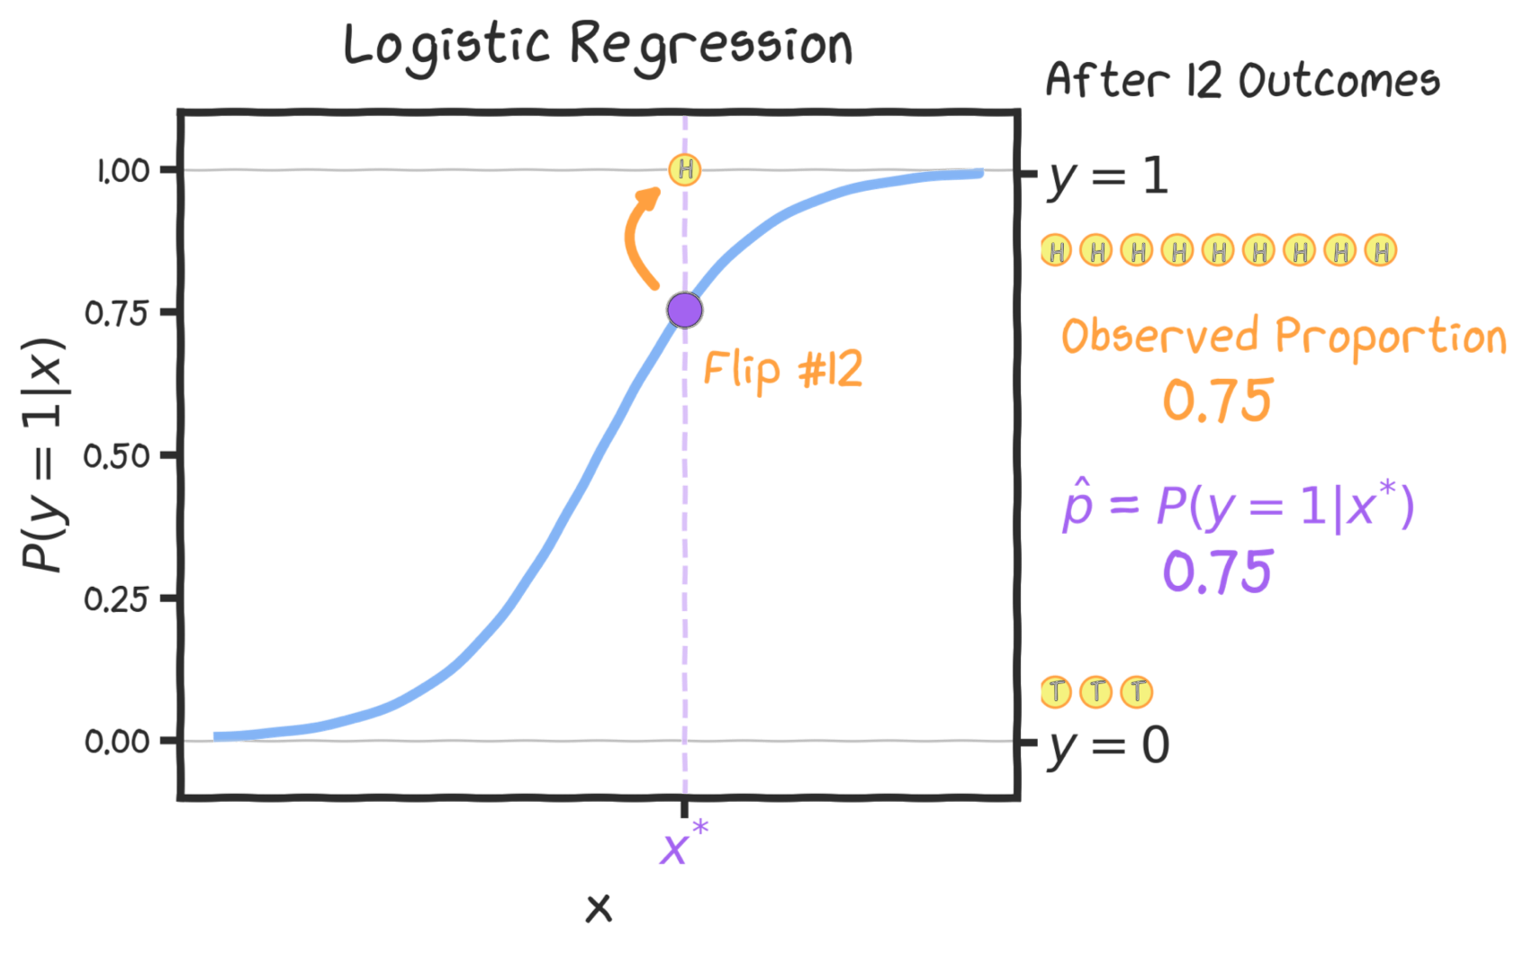

Slide 40
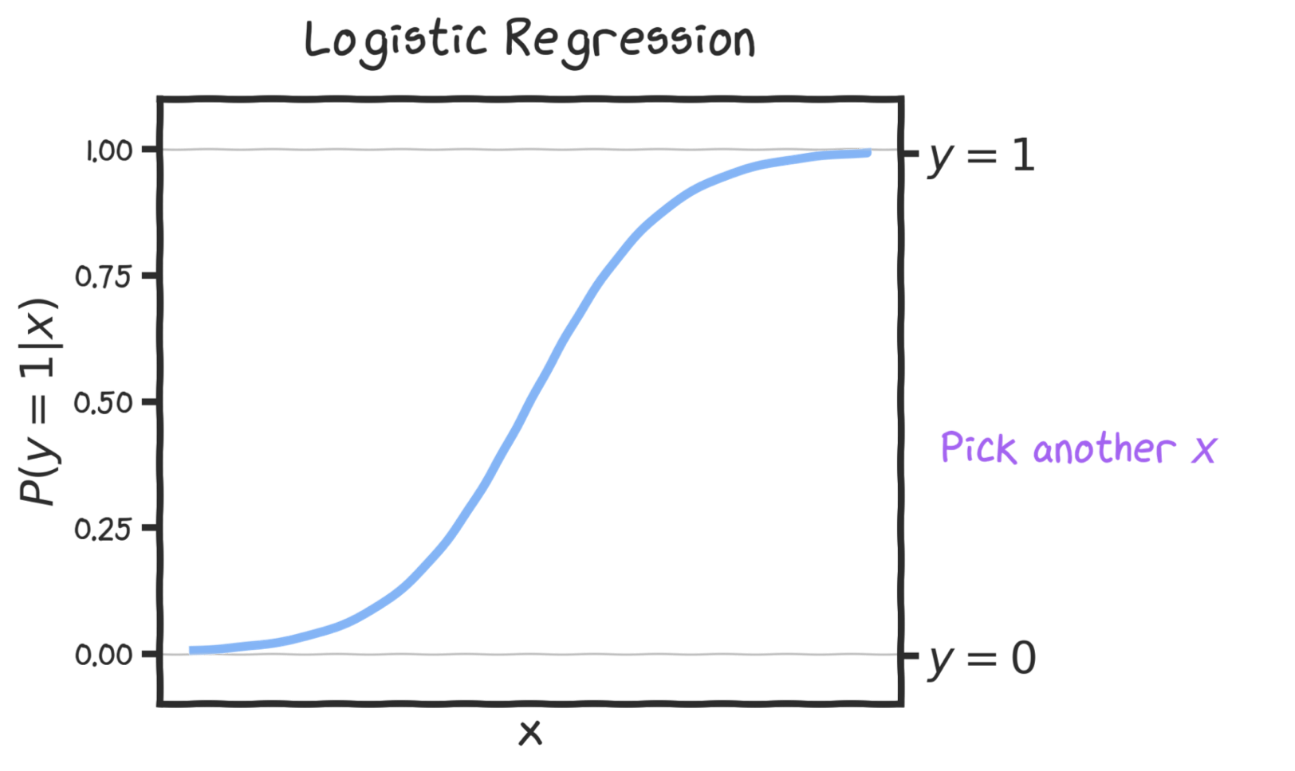

Slide 41
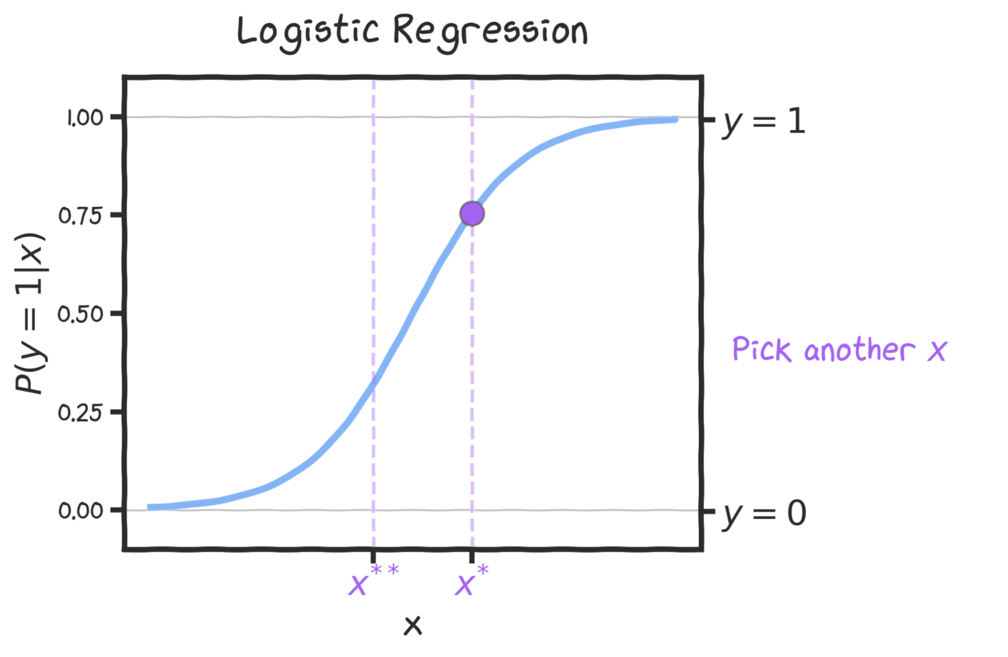

Slide 42
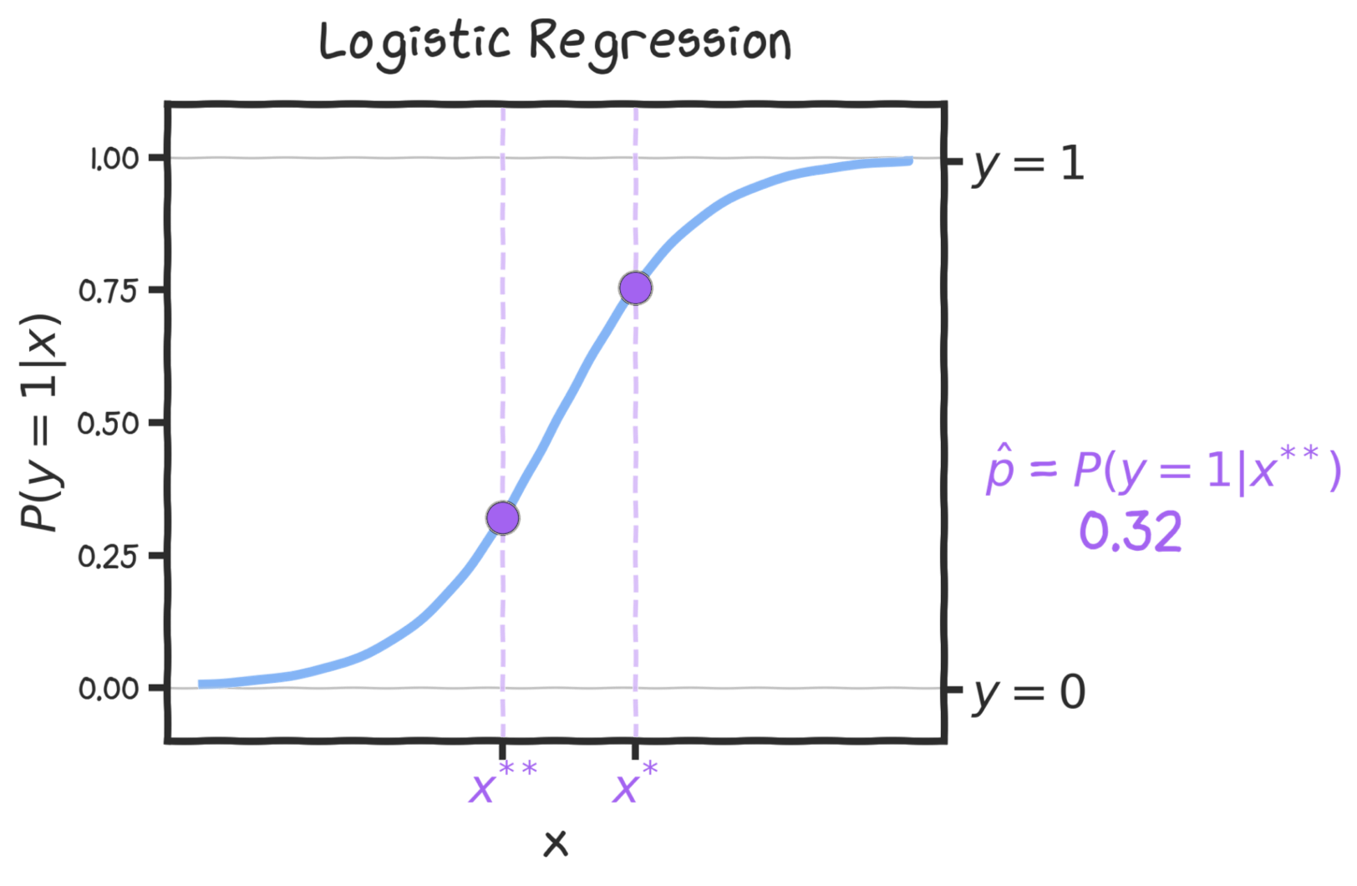

Slide 43
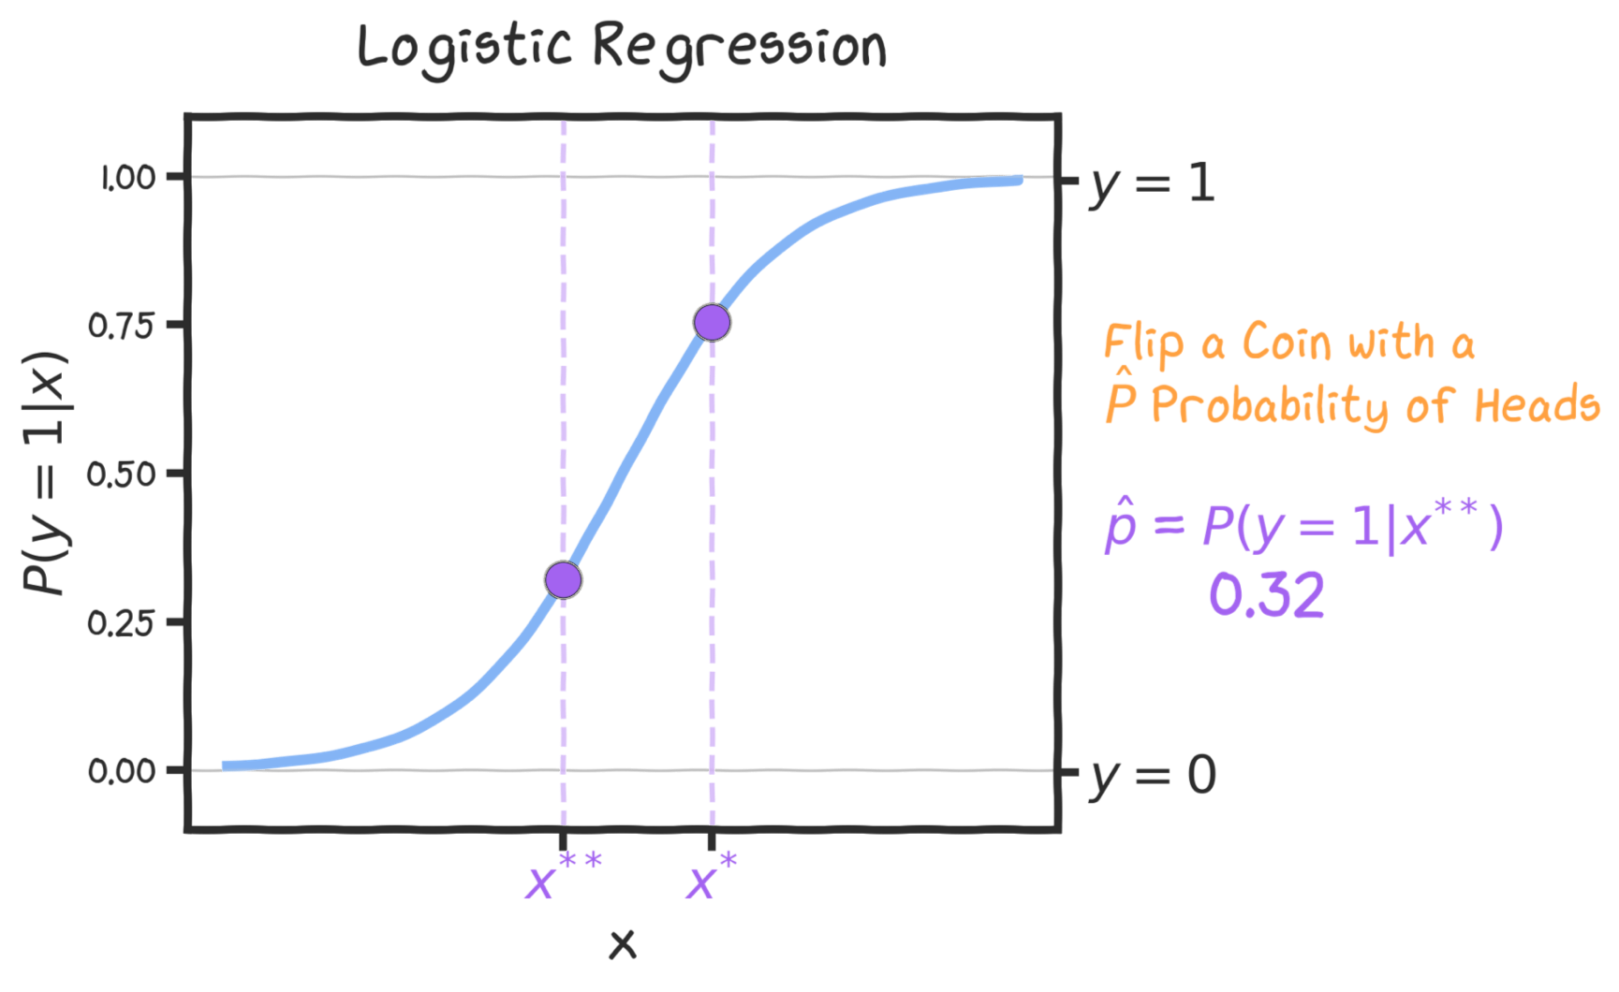

Slide 44
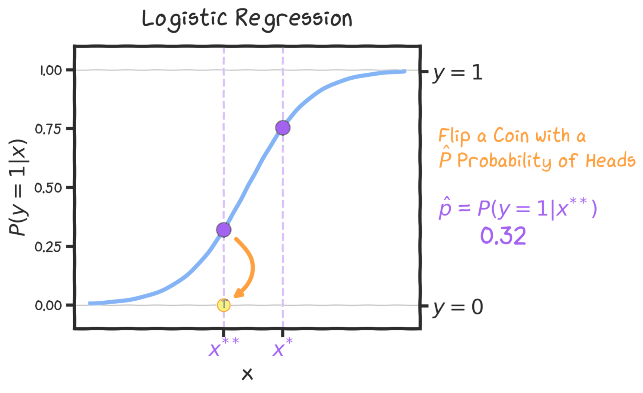

Slide 45
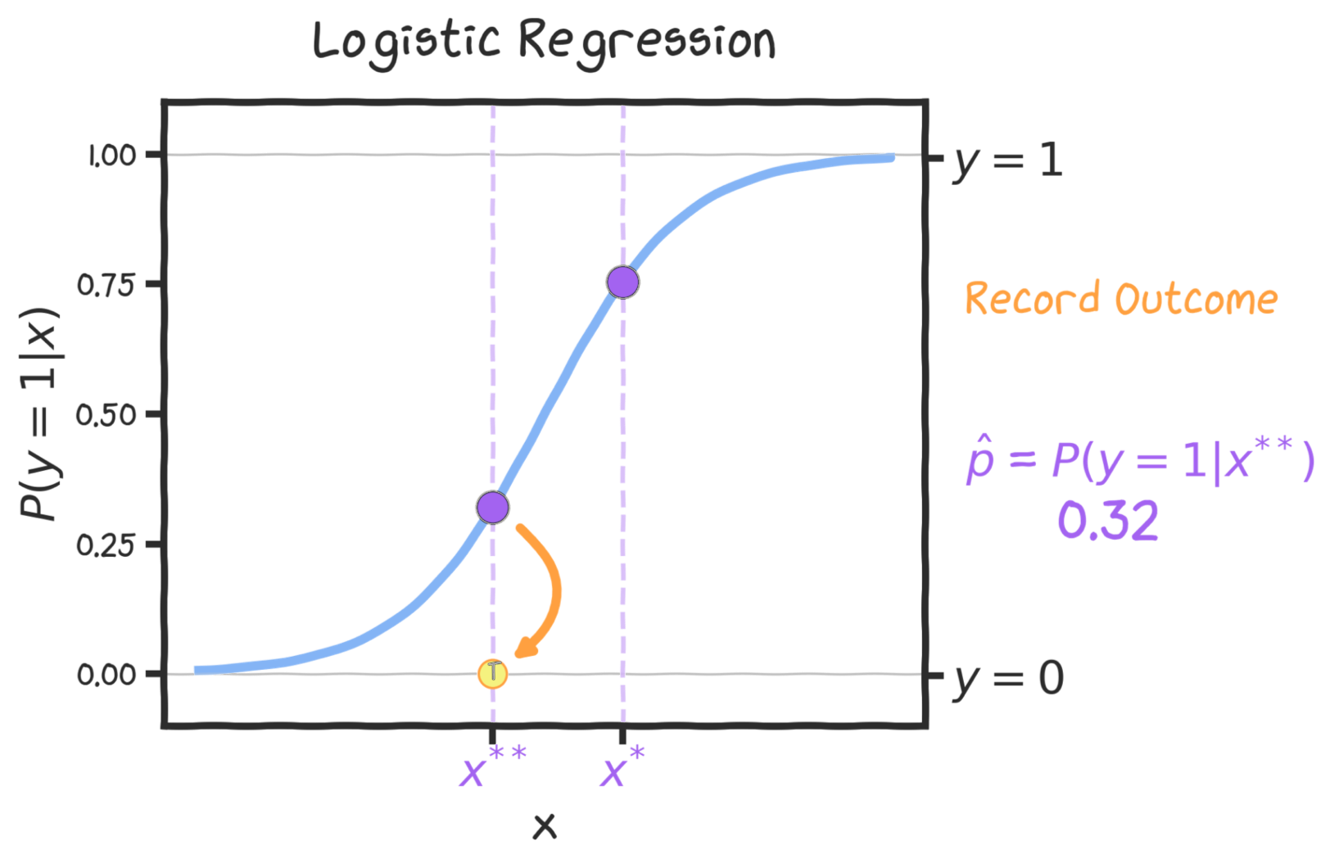

Slide 46
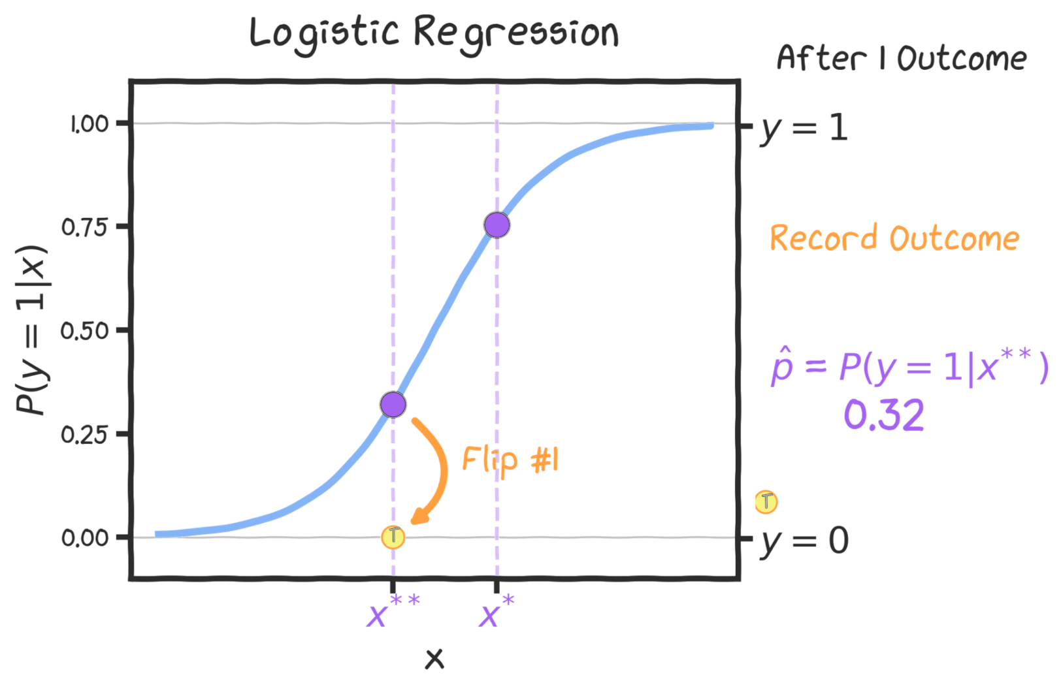

Slide 47
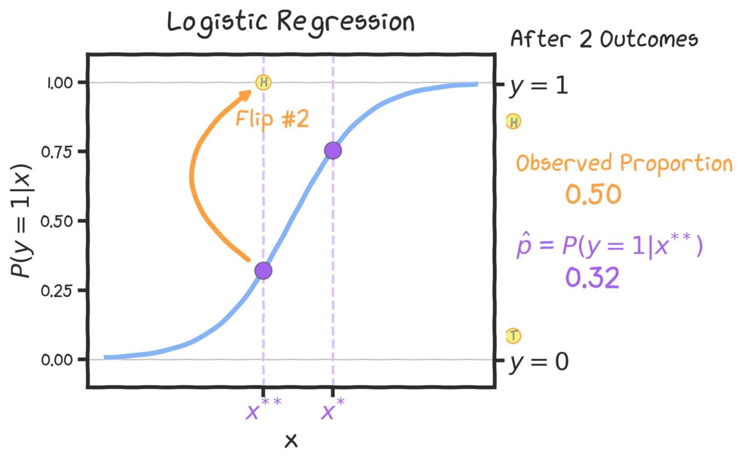

Slide 48
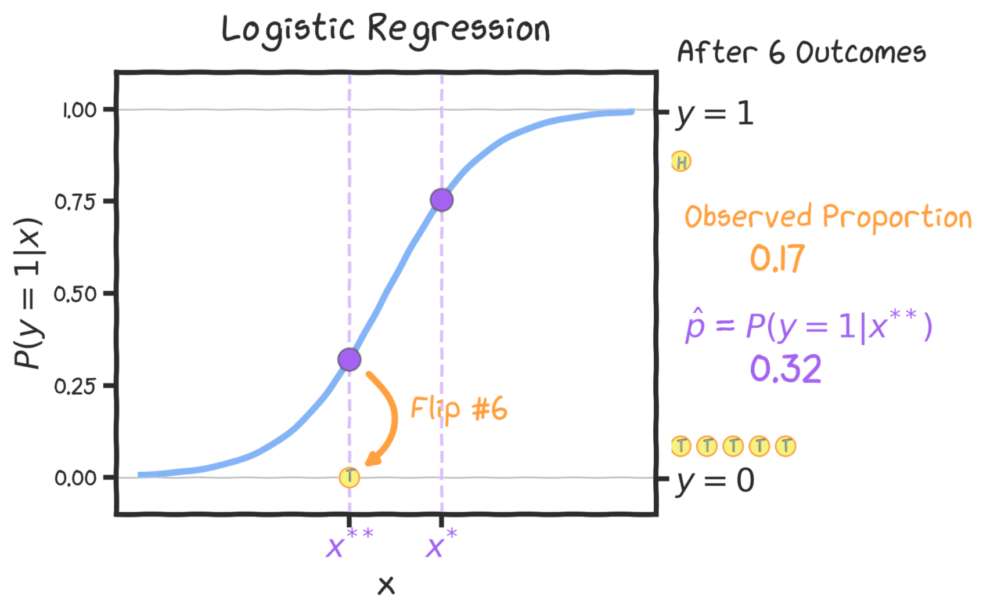

Slide 49
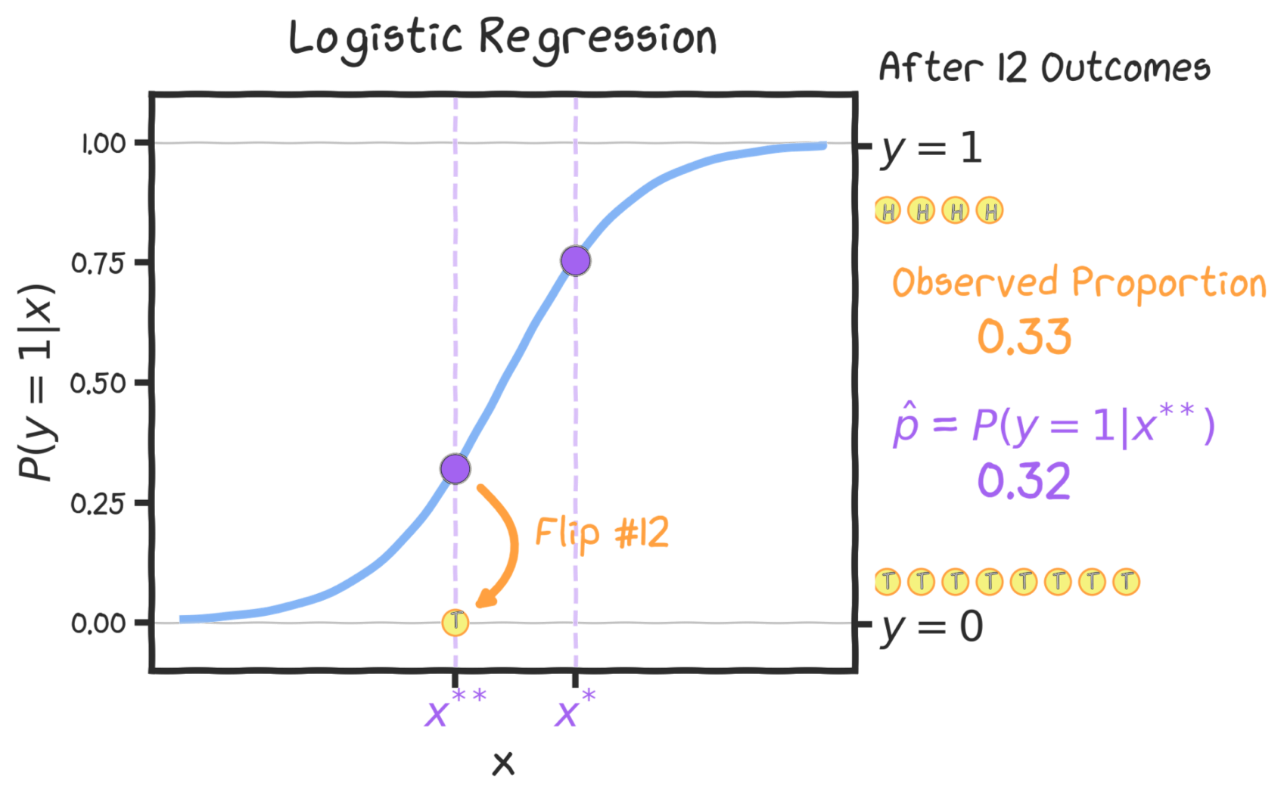

Slide 50
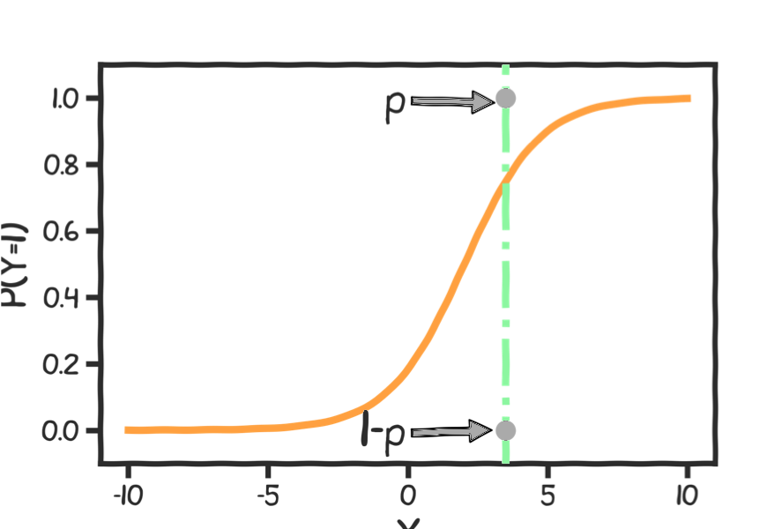
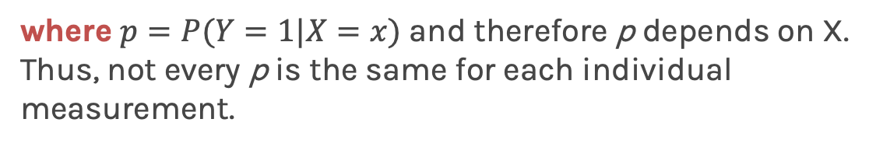
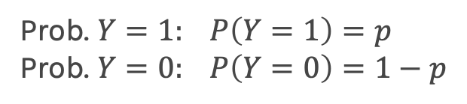

Estimating the Simple Logistic Model
For any X, the probability of getting heads or tails (1 or 0) is given by the logistic function shown in the plot as an orange line.
}
Prob. $Y=1: P\left(Y=1\right)=p$
Prob. $Y=0: P\left(Y=0\right)=1−p$
$${P\left(Y=y\right)=p}^{y}{(1−p)}^{(1−y)}$$
where $p=P(Y=1|X=x)$ and therefore p depends on X.
Thus, not every p is the same for each individual measurement.

Slide 51

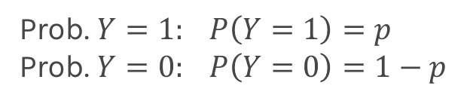

Estimating the Simple Logistic Model
For any X, the probability of getting heads or tails (1 or 0) is given by the logistic function shown in the plot as an orange line.
}
Prob. $Y=1: P\left(Y=1\right)=p$
Prob. $Y=0: P\left(Y=0\right)=1−p$
$${P\left(Y=y\right)=p}^{y}{(1−p)}^{(1−y)}$$
where $p=P(Y=1|X=x)$ and therefore p depends on X.
Thus, not every p is the same for each individual measurement.

Slide 52
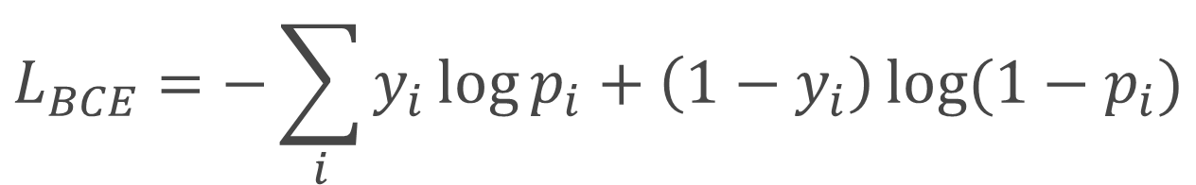
Estimating the Simple Logistic Model
$${\text{The} \text{model} \text{takes} \text{the} \text{form}\text{:} P\left(Y=y\right)=p}^{y}{(1−p)}^{(1−y)}$$
The loss function that we use for Logistic Regression is not MSE, but Binary Cross Entropy.
The Binary Cross Entropy is expressed as follows:
$$L_{BCE}=−\sum_{i}{y_{i}\log{p_{i}+\left(1−y_{i}\right)\log{(1−p_{i})}}}$$

Slide 53
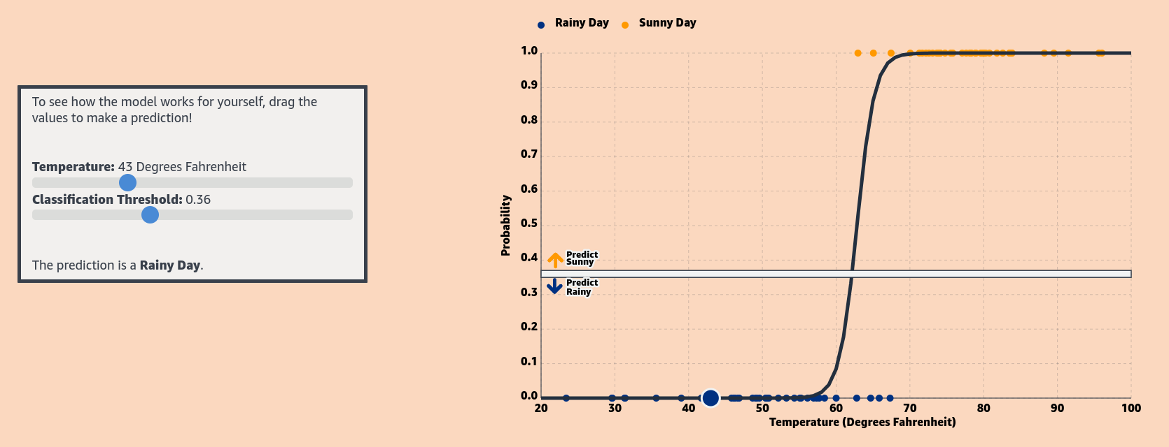
Side Note: MLU-Explain
MLU-Explain from Amazon hosts many interactive visual explanations of core machine learning concepts. Their page for logistic regression is a great resource!
https://mlu-explain.github.io/logistic-regression/

Slide 54
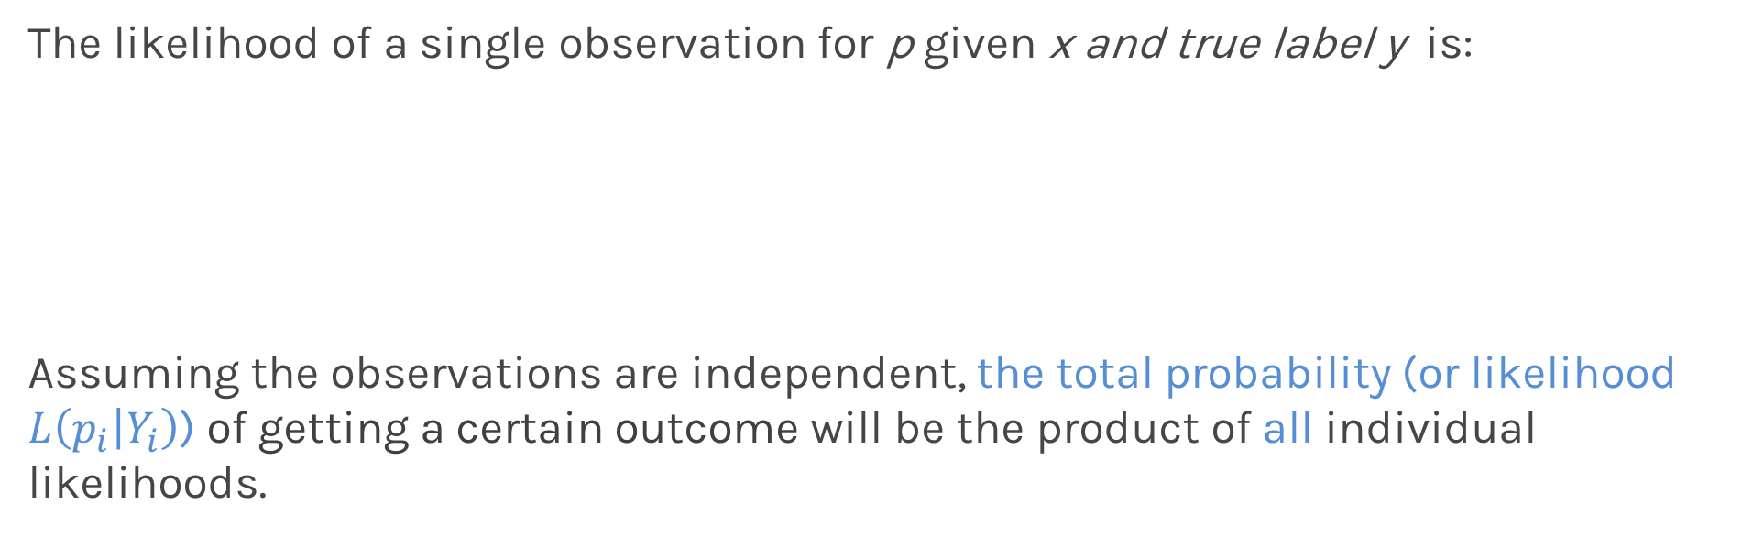

Estimating the Simple Logistic Model
The likelihood of a single observation for p given x and true label y is:
Assuming the observations are independent, the total probability (or likelihood $L\left(p_{i} | Y_{i}\right)$) of getting a certain outcome will be the product of all individual likelihoods.
$$L\left(p_{i} | Y_{i}\right)=P\left(Y_{i}=y_{i}\right)=p_{i}^{y_{i}}{\left(1−p_{i}\right)}^{1−y_{i}}$$
$$L\left(p | Y\right)=\prod_{i}{P\left(Y_{i}=y_{i}\right)=\prod_{i}{p_{i}^{y_{i}}{\left(1−p_{i}\right)}^{1−y_{i}}}}$$

Slide 55


Estimating the Simple Logistic Model
$$L\left(p | Y\right)=\prod_{i}{P\left(Y_{i}=y_{i}\right)=\prod_{i}{p_{i}^{y_{i}}{\left(1−p_{i}\right)}^{1−y_{i}}}}$$
The best model is the model that gives us the $argmax L\left(p | Y\right)$ .
We can adjust the $β$ values such as we get the $argmax L\left(p | Y\right)$ for our data .
Notes:
max prob is IDENTICAL to finding the minimum of the –ve log of likelihood

Slide 56


Estimating the Simple Logistic Model
$$L\left(p | Y\right)=\prod_{i}{P\left(Y_{i}=y_{i}\right)=\prod_{i}{p_{i}^{y_{i}}{\left(1−p_{i}\right)}^{1−y_{i}}}}$$
We usually do not like to deal with products, so we can show that finding the $argmax L\left(p | Y\right)$is INDENTICAL to finding the $argmin(−\log\left(L\left(p | Y\right)\right)$:
First, we note that:
$$\underset{β}{argmax}{(L\left(p | y\right))=\underset{β}{argmax}{(log{L\left(p | y\right))}}}$$
Notes:
max prob is IDENTICAL to finding the minimum of the –ve log of likelihood

Slide 57


Estimating the Simple Logistic Model
First, we note that:
$$\underset{β}{argmax}{(L\left(p | y\right))=\underset{β}{argmax}{(log{L\left(p | y\right))}}}$$
which we can expand as:
$$l\left(p | Y\right)=\log{L\left(p | Y\right)=}\log{\prod_{i}{p_{i}^{y_{i}}{\left(1−p_{i}\right)}^{1−y_{i}}}}=\sum_{i}{\log\left\{p_{i}^{y_{i}}{\left(1−p_{i}\right)}^{1−y_{i}}\right\}}$$

Slide 58



Estimating the Simple Logistic Model
$$l\left(p | Y\right)=\log{L\left(p | Y\right)=}\log{\prod_{i}{p_{i}^{y_{i}}{\left(1−p_{i}\right)}^{1−y_{i}}}}=\sum_{i}{\log\left\{p_{i}^{y_{i}}{\left(1−p_{i}\right)}^{1−y_{i}}\right\}}$$
We use the property that the log of a product is the sum of the logs
$$l\left(p | Y\right)=\log{L\left(p | Y\right)=}\sum_{i}{\log{p_{i}^{y_{i}}{+\log\left(1−p_{i}\right)}^{1−y_{i}}}}$$
And that $\log{a^{b}=b\log{a}}$
$$l\left(p | Y\right)=\log{L\left(p | Y\right)=}\sum_{i}{y_{i}log{p_{i}{+(1−y_{i})log\left(1−p_{i}\right)}^{}}}$$

Slide 59


Estimating the Simple Logistic Model
Maximizing a function is equivalent to minimizing the negative of the function
$\underset{β}{argmax}{L\left(p | y\right)=\underset{β}{argmax}{\log{L\left(p | y\right)}}}$= $\underset{β}{argmin} (−\log{L\left(p | y\right))}$= $\underset{β}{argmin (−}l\left(p | Y\right)$)
Using the formula for the log-likelihood, we get
$β^{∗}= \underset{β}{argmin (−}l\left(p | Y\right)$ ) = - $\sum_{i}{y_{i}log{p_{i}^{}{+(1−y_{i})log\left(1−p_{i}\right)}^{}}}$
The final loss, called the Binary Cross Entropy, is then:
$$L_{BCE}=−\sum_{i}{y_{i}\log{p_{i}+\left(1−y_{i}\right)\log{(1−p_{i})}}}$$

Slide 60


Food for thought:
Who came up with logistic regression? Why the logistic function again?
Why is the logistic function used as the S-shaped curve? What other functions could be used?
Stat 110 Idea: any CDF function (unbounded and continuous) could be used as the S-shaped curve. Econometricians love to use $Φ(β_{0}+β_{1}X_{1}+…)$.

Slide 61
Outline
What is Classification?
Why not Linear Regression?
Estimating the Simple Logistic Model
Inference in Logistic Regression
Multiple Logistic Regression
Classification Decision Boundaries

Slide 62


Statistical Inference in Logistic Regression
Just like in linear regression, when the predictor, $X$, is binary, the interpretation of the model simplifies.
In this case, what are the interpretations of ${\hat{β}}_{0}$and ${\hat{β}}_{1}?$
Consider the heart disease dataset represented here:
If we predict heart disease based on biological sex, how would you calculate and interpret the coefficient estimates ${\hat{β}}_{0}$and ${\hat{β}}_{1}$ ?

Slide 63



A Second Logistic Regression Model in sklearn
Here is a logistic regression output to predict Y = AHD from X = Female:
What is the estimated model? What are the interpretations of the $\hat{β}$s?
$$ln\left(\frac{\hat{P}\left(Y=1\right)}{1−\hat{P}\left(Y=1\right)}\right) =0.2144−1.272\left(Female\right)$$
What is the estimated log-odd of AHD for Females and for Males? What about estimated probabilities? How does this agree with the table?

Slide 64


Statistical Inference in Logistic Regression
The uncertainty of the estimates ${\hat{β}}_{0}$and ${\hat{β}}_{1}$ can be quantified and used to calculate both confidence intervals and hypothesis tests.
Of course, you can use bootstrapping (CI) and permutation testing (hypothesis testing) to perform these I es.
Note:
The estimate for the standard errors of these estimates without bootstrap, is based on a quantity called Fisher's Information (beyond the scope of this class), which is related to the curvature of the log-likelihood function (the second derivative). Why does this make sense geometrically?
Due to the nature of the underlying Bernoulli distribution, if you estimate the underlying proportion $p_{i},$you get the variance for free! Because of this, the inferences will be based on the normal approximation (and not t-distribution based).

Slide 65
Outline
What is Classification?
Why not Linear Regression?
Estimating the Simple Logistic Model
Inference in Logistic Regression
Multiple Logistic Regression
Classification Decision Boundaries

Slide 66
Multiple Logistic Regression
It is simple to illustrate examples in logistic regression when there is just one predictors variable.
But the approach ‘easily’ generalizes to the situation where there are multiple predictors.
A lot of the same details as linear regression apply to logistic regression. Interactions can be considered; collinearity is a concern and so is overfitting.

Slide 67


Multiple Logistic Regression
collinearity
overfitting
What are these? I’m scared!
Don’t fret! Let’s look at each of them.

Slide 68

Collinearity
Collinearity refers to a situation where two or more predictors in a model are highly correlated with each other.
Feature 1
Feature 2
Collinearity affects our confidence in the estimated coefficients, making it challenging to assess the importance of individual predictors.

Slide 69

Overfitting
Overfitting is a common problem where a model learns the training data too well, capturing the noise and random fluctuations along with relevant patterns.
Overfitting indicates that the model has become too complex, tailoring itself too closely to the specifics of the training data.

Slide 70
Multiple Logistic Regression
So, that is what overfitting and collinearity is!
So how do we correct for such problems?
Regularization and checking though train and cross-validation!
We will get into the details of this, along with other extensions of logistic regression, in the next lecture.

Slide 71



Multiple Logistic Regression
Earlier we saw the general form of simple logistic regression, meaning when there is just one predictor used in the model:
Multiple logistic regression is a generalization to multiple predictors. More specifically we can define a multiple logistic regression model to predict $P(Y=1)$ as such:
$$\ln\left(\frac{P\left(Y=1\right)}{1−P\left(Y=1\right)}\right)= β_{0}+β_{1}X$$
$\ln\left(\frac{P\left(Y=1\right)}{1−P\left(Y=1\right)}\right)= β_{0}+β_{1}X_{1}+$ $β_{2}X_{2}+..+β_{p}X_{p}$

Slide 72


Fitting Multiple Logistic Regression
The actual fitting of a Multiple Logistic Regression is easy using software (of course there's a python package for that) as the mathematical aspect of it has already been hard coded. So, we don’t need to worry about it!
In the sklearn.linear_model package, you just have to create your multidimensional design matrix $X$ to be used as predictors in the LogisticRegression function.

Slide 73

Interpretation of Multiple Logistic Regression
Interpreting the coefficients in a multiple logistic regression is similar to that of linear regression.
Key: since there are other predictors in the model, the coefficient $e^{{\hat{β}}_{j}}$is the multiplicative change in odds between the $j^{th}$ predictor and the response. But do we have to say, “Controlling for the other predictors in the model”?
We are trying to attribute the partial effects of each model controlling for the others (aka, controlling for possible confounders).
Multicollinearity plays a role just like in linear regression.

Slide 74
Outline
What is Classification?
Why not Linear Regression?
Estimating the Simple Logistic Model
Inference in Logistic Regression
Multiple Logistic Regression
Classification Decision Boundaries

Slide 75

Using Logistic Regression for Classification
How can we use logistic regression to perform classification?
That is, how can we predict when $Y=1$ vs. when $Y=0$?
We can classify all observations for which:
Classify all observations with $\hat{P}(Y=1)≥0.5$to be in the group associated with $Y=1$.
Classify all observations with $\hat{P}\left(Y=1\right)<0.5$to be in the group associated with $Y=0$.
How would this extend if $Y$has 3+ classes?

Slide 76

Decision Boundaries for Classification
Recall that we could attempt to purely classify each observation based on whether the estimated $P(Y=1)$ from the model is at least 0.5:
$$\hat{P}(Y=1)≥0.5$$
This results in a decision boundary: a surface (line, curve, etc. in 2D) that separates the predicted classes into sets.

Slide 77

Decision Boundaries for Classification
Here’s a 2-D plot from our Heart Data Set:
How do you expect logistic regression to draw the decision boundary?

Slide 78


Decision Boundaries Example
Here is the output from a logistic regression model with 2 predictors:
What is the estimated model?
$ln\left(\frac{\hat{P}\left(Y=1\right)}{1−\hat{P}\left(Y=1\right)}\right) =5.423−0.0439\left(MaxHR\right)+0.0039(Chol)$
What will the decision boundary look like? Key: if $\hat{P}\left(Y=1\right)=0.5$, then what are the estimated odds? What are the estimated log-odds?
In logistic regression, the decision boundary is defined when $Xβ=0$.

Slide 79

2D Classification in Logistic Regression: Example #1
A logistic regression model was fit to predict Y = AHD from X₁ = MaxHR and X₂ = Chol. Results shown below:
What will the decision boundary look like?
In logistic regression, decision boundaries are structured to be linear!

Slide 80


2D Classification in Logistic Regression: Example #2
A logistic regression model was fit to predict Y = AHD from X₁ = MaxHR and X₂ = Chol, and X₃ = their interaction. Results are shown below:
What will the decision boundary look like?
In logistic regression, decision boundaries are not always structured to be linear!

Slide 81

2D Classification in Logistic Regression: Example #2
A logistic regression model was fit to predict Y = AHD from X₁ = MaxHR and X₂ = Chol, and X₃ = their interaction. Results are shown below:
What will the decision boundary look like?
In logistic regression, decision boundaries are not always structured to be linear!

Slide 82



Polynomial Logistic Regression
We saw a 2-D plot last time which had two predictors, $X_{1},X_{2}$. A similar one is shown here but the decision boundary is again not linear.
We can extend multiple Logistic Regression as we did with polynomial regression:
We transform the data by adding new predictors:
$\tilde{x}=[1, {\tilde{x}}_{1}$, ${\tilde{x}}_{2}, …,{\tilde{x}}_{M}]$
where ${\tilde{x}}_{k}=x^{k}$.
The polynomial Logistic Regression can be expressed as:
$$\log\left(\frac{P\left(Y=1\right)}{1−P\left(Y=1\right)}\right)= \tilde{X}β$$

Slide 83



Geometry of Decision Boundaries (Logistic Regression)
$$\log\left(\frac{P\left(Y=1\right)}{1−P\left(Y=1\right)}\right)= \tilde{X}β$$
Thus, we can define our logistic regression model to achieve a desired geometry.
For example, what set for $X=f(X_{1},X_{2})$ should we choose if we want a circular decision boundary?
$X=\{X_{1},X_{1}^{2}{,X}_{2},X_{2}^{2},X_{1}X_{2}\}$
What could be an alternative modeling approach (think outside of logistic regression)?

Slide 84
Thank you!

